Slide 1
Chapter 5 Concurrency: Mutual Exclusion and Synchronization
Operating Systems: Internals and Design Principles
Ninth Edition
By William Stallings
Notes:
“Operating Systems: Internals and Design Principles”, 9/e, by William Stallings, Chapter 5 “Concurrency: Mutual Exclusion and Synchronization”.

Slide 2
Multiple Processes
Operating System design is concerned with the management of processes and threads:
Multiprogramming
The management of multiple processes within a uniprocessor system
Multiprocessing
The management of multiple processes within a multiprocessor
Distributed Processing
The management of multiple processes executing on multiple, distributed computer systems
The recent proliferation of clusters is a prime example of this type of system
Notes:
The central themes of operating system design are all concerned with the management of processes and threads:
• Multiprogramming: The management of multiple processes within a uniprocessor system
• Multiprocessing : The management of multiple processes within a multiprocessor
• Distributed processing: The management of multiple processes executing on multiple, distributed computer systems. The recent proliferation of clusters is a prime example of this type of system.

Slide 3
Concurrency Arises in Three Different Contexts:
Multiple Applications
Invented to allow processing time to be shared among active applications
Structured Applications
Extension of modular design and structured programming
Operating System Structure
OS themselves implemented as a set of processes or threads
Notes:
Fundamental to all of these areas, and fundamental to OS design, is concurrency. Concurrency encompasses a host of design issues, including communication among processes, sharing of and competing for resources (such as memory, files, and I/O access), synchronization of the activities of multiple processes, and allocation of processor time to processes. We shall see that these issues arise not just in multiprocessing and distributed processing environments but even in single-processor multiprogramming systems.
Concurrency arises in three different contexts:
• Multiple applications: Multiprogramming was invented to allow processing time to be dynamically shared among a number of active applications.
• Structured applications: As an extension of the principles of modular design and structured programming, some applications can be effectively programmed as a set of concurrent processes.
Operating system structure: The same structuring advantages apply to systems programs, and we have seen that operating systems are themselves often implemented as a set of processes or threads.

Slide 4

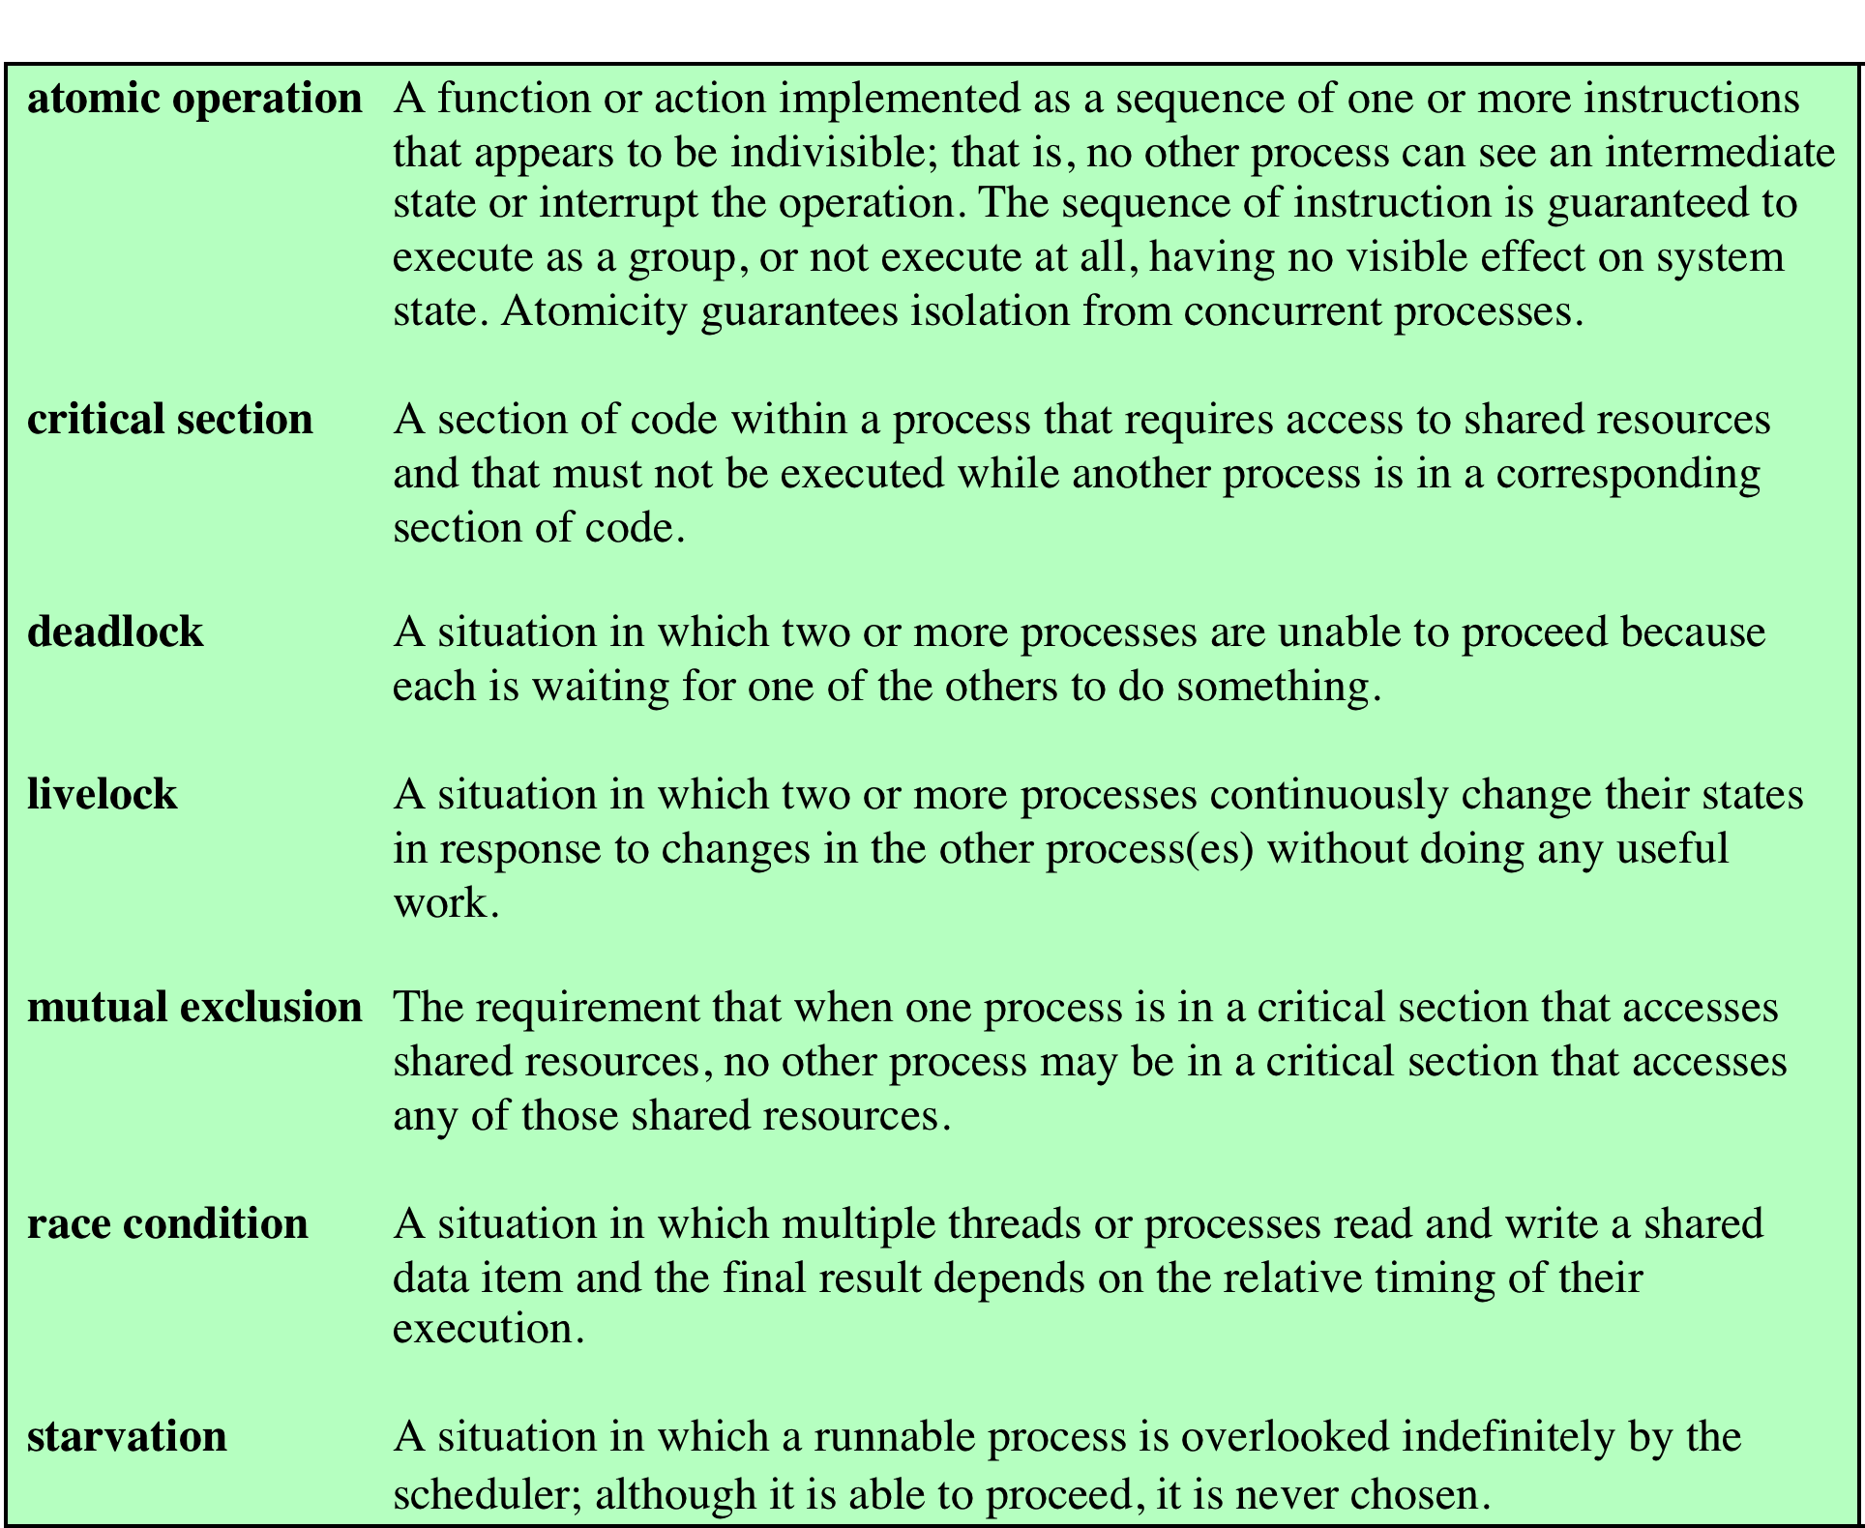
Table 5.1
Some Key Terms Related
to Concurrency
Notes:
Table 5.1 lists some
key terms related to concurrency. A set of animations that illustrate concepts in this
chapter is available at the Companion website for this book.

Slide 5
Mutual Exclusion: Software Approaches
Software approaches can be implemented for concurrent processes that execute on a single-processor or a multiprocessor machine with shared main memory
These approaches usually assume elementary mutual exclusion at the memory access level
Simultaneous accesses (reading and/or writing) to the same location in main memory are serialized by some sort of memory arbiter, although the order of access granting is not specified ahead of time
Beyond this, no support in the hardware, operating system, or programming language is assumed
Dijkstra reported an algorithm for mutual exclusion for two processes, designed by the Dutch mathematician Dekker
Following Dijkstra, we develop the solution in stages
This approach has the advantage if illustrating many of the common bugs encountered in developing concurrent programs
Notes:
Software approaches can be implemented for concurrent processes that execute on
a single-processor or a multiprocessor machine with shared main memory. These
approaches usually assume elementary mutual exclusion at the memory access level
([LAMP91], but see Problem 5.3). That is, simultaneous accesses (reading and/or
writing) to the same location in main memory are serialized by some sort of memory
arbiter, although the order of access granting is not specified ahead of time. Beyond
this, no support in the hardware, operating system, or programming language is
assumed.
Dijkstra [DIJK65] reported an algorithm for mutual exclusion for two processes,
designed by the Dutch mathematician Dekker. Following Dijkstra, we develop the
solution in stages. This approach has the advantage of illustrating many of the common
bugs encountered in developing concurrent programs.

Slide 6
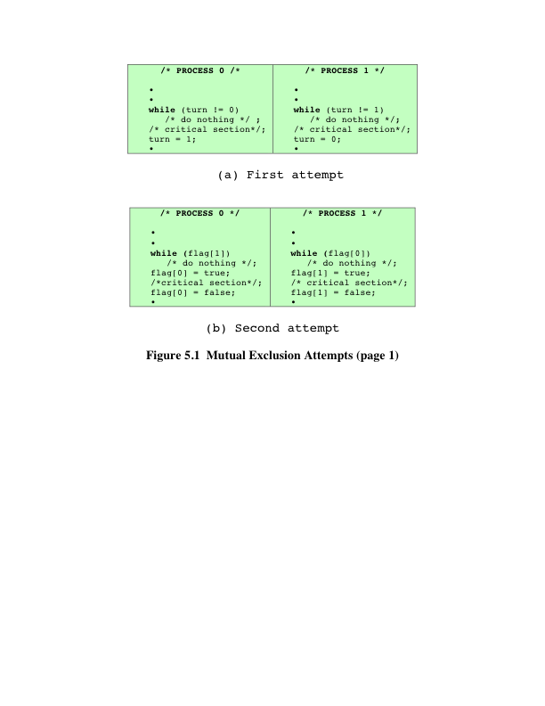
Notes:
First Attempt
As mentioned earlier, any attempt at mutual exclusion must rely
on some fundamental exclusion mechanism in the hardware. The most common of
these is the constraint that only one access to a memory location can be made at a
time. Using this constraint, we reserve a global memory location labeled turn. A
process (P0 or P1) wishing to execute its critical section first examines the contents
of turn. If the value of turn is equal to the number of the process, then the process
may proceed to its critical section. Otherwise, it is forced to wait. Our waiting process
repeatedly reads the value of turn until it is allowed to enter its critical section. This
procedure is known as busy waiting, or spin waiting, because the thwarted process
can do nothing productive until it gets permission to enter its critical section. Instead,
it must linger and periodically check the variable; thus it consumes processor time
(busy) while waiting for its chance.
After a process has gained access to its critical section, and after it has completed
that section, it must update the value of turn to that of the other process.
In formal terms, there is a shared global variable:
int turn = 0;
Figure 5.1a shows the program for the two processes. This solution guarantees
the mutual exclusion property but has two drawbacks. First, processes must strictly
alternate in their use of their critical section; therefore, the pace of execution is dictated
by the slower of the two processes. If P0 uses its critical section only once per
hour, but P1 would like to use its critical section at a rate of 1,000 times per hour, P1
is forced to adopt the pace of P0. A much more serious problem is that if one process
fails, the other process is permanently blocked. This is true whether a process fails in
its critical section or outside of it.
The foregoing construction is that of a coroutine . Coroutines are designed to
be able to pass execution control back and forth between themselves (see Problem
5.5). While this is a useful structuring technique for a single process, it is inadequate
to support concurrent processing.
Second Attempt
The flaw in the first attempt is that it stores the name of the
process that may enter its critical section, when in fact we need state information
about both processes. In effect, each process should have its own key to the critical
section so that if one fails, the other can still access its critical section. To meet this
requirement a Boolean vector flag is defined, with flag[0] corresponding to P0
and flag[1] corresponding to P1. Each process may examine the other’s flag but
may not alter it. When a process wishes to enter its critical section, it periodically
checks the other’s flag until that flag has the value false, indicating that the other
process is not in its critical section. The checking process immediately sets its own
flag to true and proceeds to its critical section. When it leaves its critical section, it
sets its flag to false.
The shared global variable now is
enum boolean (false = 0; true = 1);
boolean flag[2] = 0, 0
Figure 5.1b shows the algorithm. If one process fails outside the critical section,
including the flag-setting code, then the other process is not blocked. In fact, the other
process can enter its critical section as often as it likes, because the flag of the
other process is always false. However, if a process fails inside its critical section
or after setting its flag to true just before entering its critical section, then the other
process is permanently blocked.
This solution is, if anything, worse than the first attempt because it does not
even guarantee mutual exclusion. Consider the following sequence:
P0 executes the while statement and finds flag[1] set to false
Pl executes the while statement and finds flag[0] set to false
P0 sets flag[0] to true and enters its critical section
Pl sets flag[1] to true and enters its critical section
Because both processes are now in their critical sections, the program is incorrect.
The problem is that the proposed solution is not independent of relative process
execution speeds.

Slide 7
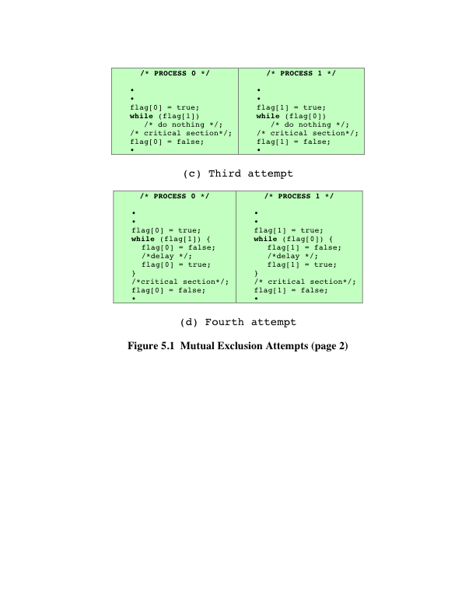
Notes:
Third Attempt
Because a process can change its state after the other process
has checked it but before the other process can enter its critical section, the second
attempt failed. Perhaps we can fix this problem with a simple interchange of two
statements, as shown in Figure 5.1c.
As before, if one process fails inside its critical section, including the flag-setting
code controlling the critical section, then the other process is blocked, and if a process
fails outside its critical section, then the other process is not blocked.
Next, let us check that mutual exclusion is guaranteed, using the point of view
of process P0. Once P0 has set flag[0] to true , Pl cannot enter its critical section
until after P0 has entered and left its critical section. It could be that Pl is already in
its critical section when P0 sets its flag. In that case, P0 will be blocked by the while
statement until Pl has left its critical section. The same reasoning applies from the
point of view of Pl.
This guarantees mutual exclusion, but creates yet another problem. If both
processes set their flags to true before either has executed the while statement,
then each will think that the other has entered its critical section, causing
deadlock.
Fourth Attempt
In the third attempt, a process sets its state without knowing the
state of the other process. Deadlock occurs because each process can insist on its right
to enter its critical section; there is no opportunity to back off from this position. We
can try to fix this in a way that makes each process more deferential: Each process
sets its flag to indicate its desire to enter its critical section, but is prepared to reset
the flag to defer to the other process, as shown in Figure 5.1d.
This is close to a correct solution, but is still flawed. Mutual exclusion is still
guaranteed, using similar reasoning to that followed in the discussion of the third
attempt. However, consider the following sequence of events:
P0 sets flag[0] to true.
Pl sets flag[1] to true.
P0 checks flag[1] .
Pl checks flag[0] .
P0 sets flag[0] to false .
Pl sets flag[1] to false .
P0 sets flag[0] to true .
Pl sets flag[1] to true .
This sequence could be extended indefinitely, and neither process could enter
its critical section. Strictly speaking, this is not deadlock, because any alteration in the
relative speed of the two processes will break this cycle and allow one to enter the
critical section. This condition is referred to as livelock . Recall that deadlock occurs
when a set of processes wishes to enter their critical sections, but no process can succeed.
With livelock, there are possible sequences of executions that succeed, but it is
also possible to describe one or more execution sequences in which no process ever
enters its critical section.
Although the scenario just described is not likely to be sustained for very long,
it is nevertheless a possible scenario. Thus, we reject the fourth attempt.

Slide 8
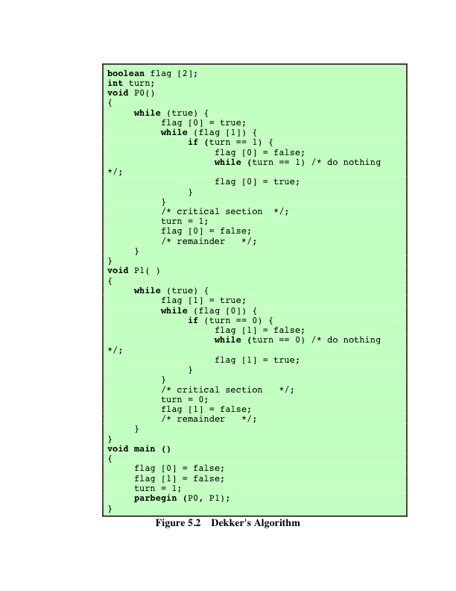
Notes:
A Correct Solution We need to be able to observe the state of both processes,
which is provided by the array variable flag . But, as the fourth attempt shows, this is
not enough. We must impose an order on the activities of the two processes to avoid
the problem of ”mutual courtesy” that we have just observed. The variable turn
from the first attempt can be used for this purpose; in this case the variable indicates
which process has the right to insist on entering its critical region.
We can describe this solution, referred to as Dekker’s algorithm, as follows.
When P0 wants to enter its critical section, it sets its flag to true . It then checks the
flag of Pl. If that is false , P0 may immediately enter its critical section. Otherwise,
P0 consults turn . If P0 finds that turn = 0 , then it knows that it is its turn to insist
and periodically checks Pl’s flag. Pl will at some point note that it is its turn to defer
and set its to flag false , allowing P0 to proceed. After P0 has used its critical section,
it sets its flag to false to free the critical section, and sets turn to l to transfer the
right to insist to Pl.
Figure 5.2 provides a specification of Dekker’s algorithm. The construct
parbegin (Pl, P2, . . . , Pn ) means the following: suspend the execution of the main
program; initiate concurrent execution of procedures Pl, P2, . . . , Pn ; when all of Pl,
P2, . . . , Pn have terminated, resume the main program. A verification of Dekker’s
algorithm is left as an exercise (see Problem 5.l).

Slide 9
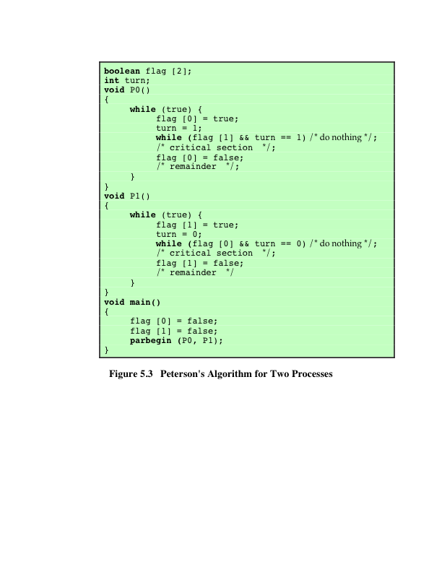
Notes:
Dekker’s algorithm solves the mutual exclusion problem, but with a rather complex
program that is difficult to follow and whose correctness is tricky to prove. Peterson
[PETE8l] has provided a simple, elegant solution. As before, the global array variable
flag indicates the position of each process with respect to mutual exclusion, and
the global variable turn resolves simultaneity conflicts. The algorithm is presented
in Figure 5.3.
That mutual exclusion is preserved is easily shown. Consider process P0.
Once it has set flag[0] to true , Pl cannot enter its critical section. If Pl already
is in its critical section, then flag[1] = true and P0 is blocked from entering its
critical section. On the other hand, mutual blocking is prevented. Suppose that P0
is blocked in its while loop. This means that flag[1] is true and turn = l . P0 can
enter its critical section when either flag[1] becomes false or turn becomes 0.
Now consider three exhaustive cases:
1. Pl has no interest in its critical section. This case is impossible, because it implies
flag[1] = false .
2. Pl is waiting for its critical section. This case is also impossible, because if
turn = l , Pl is able to enter its critical section.
3. Pl is using its critical section repeatedly and therefore monopolizing access to it.
This cannot happen, because Pl is obliged to give P0 an opportunity by setting
turn to 0 before each attempt to enter its critical section.
Thus, we have a simple solution to the mutual exclusion problem for two processes.
Furthermore, Peterson’s algorithm is easily generalized to the case of processes
[HOFR90].

Slide 10
Principles of Concurrency
Interleaving and overlapping
Can be viewed as examples of concurrent processing
Both present the same problems
Uniprocessor – the relative speed of execution of processes cannot be predicted
Depends on activities of other processes
The way the OS handles interrupts
Scheduling policies of the OS
Notes:
At first glance, it may seem that interleaving and overlapping represent fundamentally different modes of execution and present different problems. In fact, both techniques can be viewed as examples of concurrent processing, and both present the same problems. In the case of a uniprocessor, the problems stem from a basic characteristic of multiprogramming systems: The relative speed of execution of processes cannot be predicted. It depends on the activities of other processes, the way in which the OS handles interrupts, and the scheduling policies of the OS.

Slide 11
Difficulties of Concurrency
Sharing of global resources
Difficult for the OS to manage the allocation of resources optimally
Difficult to locate programming errors as results are not deterministic and reproducible
Notes:
The following difficulties arise:
1. The sharing of global resources is fraught with peril. For example, if two processes both make use of the same global variable and both perform reads and writes on that variable, then the order in which the various reads and writes are executed is critical. An example of this problem is shown in the following subsection.
2. It is difficult for the OS to manage the allocation of resources optimally. For example, process A may request use of, and be granted control of, a particular I/O channel and then be suspended before using that channel. It may be undesirable for the OS simply to lock the channel and prevent its use by other processes; indeed this may lead to a deadlock condition, as described in Chapter 6 .
3. It becomes very difficult to locate a programming error because results are typically not deterministic and reproducible (e.g., see [LEBL87, CARR89, SHEN02] for a discussion of this point).
All of the foregoing difficulties present themselves in a multiprocessor system as well, because here too the relative speed of execution of processes is unpredictable. A multiprocessor system must also deal with problems arising from the simultaneous execution of multiple processes. Fundamentally, however, the problems are the same as those for uniprocessor systems. This should become clear as the discussion proceeds.

Slide 12
Race Condition
Occurs when multiple processes or threads read and write data items
The final result depends on the order of execution
The “loser” of the race is the process that updates last and will determine the final value of the variable
Notes:
A race condition occurs when multiple processes or threads read and write data items so that the final result depends on the order of execution of instructions in the multiple processes. Let us consider two simple examples.
As a first example, suppose that two processes, P1 and P2, share the global variable a . At some point in its execution, P1 updates a to the value 1, and at some point in its execution, P2 updates a to the value 2. Thus, the two tasks are in a race to write variable a . In this example, the “loser” of the race (the process that updates last) determines the final value of a .
For our second example, consider two process, P3 and P4, that share global variables b and c , with initial values b = 1 and c = 2 . At some point in its execution, P3 executes the assignment b = b + c , and at some point in its execution, P4 executes the assignment c = b + c . Note that the two processes update different variables. However, the final values of the two variables depend on the order in which the two processes execute these two assignments. If P3 executes its assignment statement first, then the final values are b = 3 and c = 5 . If P4 executes its assignment statement first, then the final values are b = 4 and c = 3 .
Appendix A includes a discussion of race conditions using semaphores as an example.

Slide 13
Operating System Concerns
Design and management issues raised by the existence of concurrency:
The OS must:
Be able to keep track of various processes
Allocate and de-allocate resources for each active process
Protect the data and physical resources of each process against unintended interference by other processes
The functioning of a process, and the output it produces, must be independent of the speed at which its execution is carried out relative to the speed of other concurrent processes
And
Notes:
What design and management issues are raised by the existence of concurrency?
We can list the following concerns:
1. The OS must be able to keep track of the various processes. This is done with the use of process control blocks and was described in Chapter 4 .
2. The OS must allocate and de-allocate various resources for each active process.
At times, multiple processes want access to the same resource. These resources include
• Processor time: This is the scheduling function, discussed in Part Four.
• Memory: Most operating systems use a virtual memory scheme. The topic is addressed in Part Three.
• Files: Discussed in Chapter 12 .
• I/O devices: Discussed in Chapter 11 .
3. The OS must protect the data and physical resources of each process against
unintended interference by other processes. This involves techniques that relate to memory, files, and I/O devices. A general treatment of protection is found in Part Seven .
4. The functioning of a process, and the output it produces, must be independent
of the speed at which its execution is carried out relative to the speed of other
concurrent processes. This is the subject of this chapter.

Slide 14
Table 5.2
Process Interaction
Notes:
We can classify the ways in which processes interact on the basis of the degree to which they are aware of each other’s existence. Table 5.2 lists three possible degrees of awareness plus the consequences of each:
• Processes unaware of each other: These are independent processes that are not
intended to work together. The best example of this situation is the multiprogramming of multiple independent processes. These can either be batch jobs or interactive sessions or a mixture. Although the processes are not working together, the OS needs to be concerned about competition for resources. For example, two independent applications may both want to access the same disk or file or printer. The OS must regulate these accesses.
• Processes indirectly aware of each other: These are processes that are not necessarily
aware of each other by their respective process IDs but that share access to some object, such as an I/O buffer. Such processes exhibit cooperation in sharing the common object.
• Processes directly aware of each other: These are processes that are able to
communicate with each other by process ID and that are designed to work jointly on some activity. Again, such processes exhibit cooperation .
Conditions will not always be as clear-cut as suggested in Table 5.2 . Rather, several processes may exhibit aspects of both competition and cooperation. Nevertheless, it is productive to examine each of the three items in the preceding list separately and determine their implications for the OS.

Slide 15
Resource Competition
Concurrent processes come into conflict when they are competing for use of the same resource
For example: I/O devices, memory, processor time, clock
In the case of competing processes three control problems must be faced:
The need for mutual exclusion
Deadlock
Starvation
Notes:
Concurrent processes come into conflict with each other when they are competing for the use of the same resource. In its pure form, we can describe the situation as follows. Two or more processes need to access a resource during the course of their execution. Each process is unaware of the existence of other processes, and each is to be unaffected by the execution of the other processes. It follows from this that each process should leave the state of any resource that it uses unaffected. Examples of resources include I/O devices, memory, processor time, and the clock.
There is no exchange of information between the competing processes. However, the execution of one process may affect the behavior of competing processes. In particular, if two processes both wish access to a single resource, then one process will be allocated that resource by the OS, and the other will have to wait. Therefore, the process that is denied access will be slowed down. In an extreme case, the blocked process may never get access to the resource and hence will never terminate successfully.
In the case of competing processes three control problems must be faced. First is the need for mutual exclusion . Suppose two or more processes require access to a single non-sharable resource, such as a printer. During the course of execution, each process will be sending commands to the I/O device, receiving status information, sending data, and/or receiving data. We will refer to such a resource as a critical resource , and the portion of the program that uses it as a critical section of the program. It is important that only one program at a time be allowed in its critical section. We cannot simply rely on the OS to understand and enforce this restriction because the detailed requirements may not be obvious. In the case of the printer, for example, we want any individual process to have control of the printer while it prints an entire file. Otherwise, lines from competing processes will be interleaved.
The enforcement of mutual exclusion creates two additional control problems. One is that of deadlock . For example, consider two processes, P1 and P2, and two resources, R1 and R2. Suppose that each process needs access to both resources to perform part of its function. Then it is possible to have the following situation: the OS assigns R1 to P2, and R2 to P1. Each process is waiting for one of the two resources. Neither will release the resource that it already owns until it has acquired the other resource and performed the function requiring both resources. The two processes are deadlocked.
A final control problem is starvation . Suppose that three processes (P1, P2, P3) each require periodic access to resource R. Consider the situation in which P1 is in possession of the resource, and both P2 and P3 are delayed, waiting for that resource. When P1 exits its critical section, either P2 or P3 should be allowed access to R. Assume that the OS grants access to P3 and that P1 again requires access before P3 completes its critical section. If the OS grants access to P1 after P3 has finished, and subsequently alternately grants access to P1 and P3, then P2 may indefinitely be denied access to the resource, even though there is no deadlock situation.

Slide 16
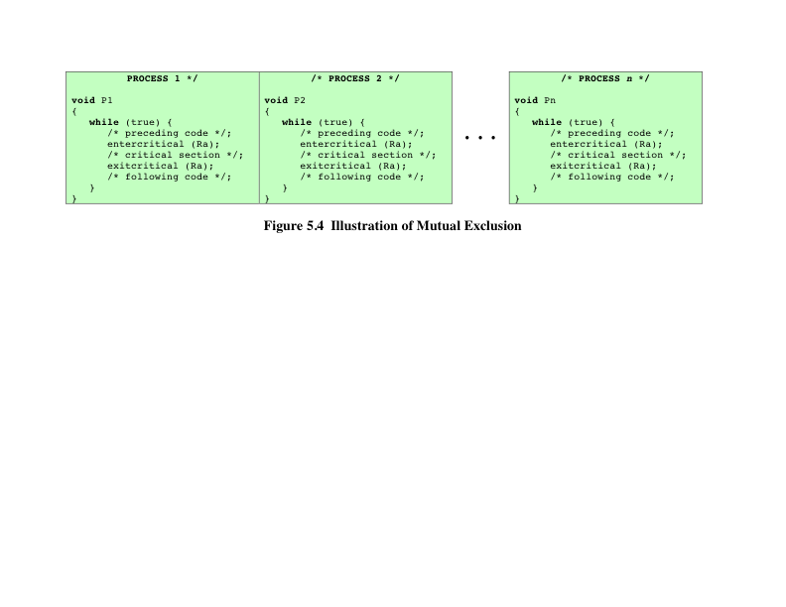
Notes:
Control of competition inevitably involves the OS because it is the OS that allocates resources. In addition, the processes themselves will need to be able to express the requirement for mutual exclusion in some fashion, such as locking a resource prior to its use. Any solution will involve some support from the OS, such as the provision of the locking facility.
Figure 5.4 illustrates the mutual exclusion mechanism in abstract terms. There are n processes to be executed concurrently. Each process includes (1) a critical section that operates on some resource Ra, and (2) additional code preceding and following the critical section that does not involve access to Ra. Because all processes access the same resource Ra, it is desired that only one process at a time be in its critical section. To enforce mutual exclusion, two functions are provided: entercritical and exitcritical . Each function takes as an argument the name of the resource that is the subject of competition. Any process that attempts to enter its critical section while another process is in its critical section, for the same resource, is made to wait.
It remains to examine specific mechanisms for providing the functions entercritical and exitcritical . For the moment, we defer this issue while we consider the other cases of process interaction.

Slide 17
Cooperation Among Processes by Sharing
Covers processes that interact with other processes without being explicitly aware of them
Processes may use and update the shared data without reference to other processes, but know that other processes may have access to the same data
Thus the processes must cooperate to ensure that the data they share are properly managed
The control mechanisms must ensure the integrity of the shared data
Because data are held on resources (devices, memory), the control problems of mutual exclusion, deadlock, and starvation are again present
The only difference is that data items may be accessed in two different modes, reading and writing, and only writing operations must be mutually exclusive
Notes:
The case of cooperation by sharing
covers processes that interact with other processes without being explicitly aware of
them. For example, multiple processes may have access to shared variables or to shared
files or databases. Processes may use and update the shared data without reference to
other processes, but know that other processes may have access to the same data. Thus
the processes must cooperate to ensure that the data they share are properly managed.
The control mechanisms must ensure the integrity of the shared data.
Because data are held on resources (devices, memory), the control problems
of mutual exclusion, deadlock, and starvation are again present. The only difference
is that data items may be accessed in two different modes, reading and writing, and
only writing operations must be mutually exclusive.

Slide 18
Cooperation Among Processes by Communication
The various processes participate in a common effort that links all of the processes
The communication provides a way to synchronize, or coordinate, the various activities
Typically, communication can be characterized as consisting of messages of some sort
Primitives for sending and receiving messages may be provided as part of the programming language or provided by the OS kernel
Mutual exclusion is not a control requirement for this sort of cooperation
The problems of deadlock and starvation are still present
Notes:
In the first two cases that
we have discussed, each process has its own isolated environment that does not
include the other processes. The interactions among processes are indirect. In both
cases, there is a sharing. In the case of competition, they are sharing resources without
being aware of the other processes. In the second case, they are sharing values, and
although each process is not explicitly aware of the other processes, it is aware of
the need to maintain data integrity. When processes cooperate by communication,
however, the various processes participate in a common effort that links all of the
processes. The communication provides a way to synchronize, or coordinate, the
various activities.
Typically, communication can be characterized as consisting of messages of
some sort. Primitives for sending and receiving messages may be provided as part of
the programming language or provided by the OS kernel.
Because nothing is shared between processes in the act of passing messages,
mutual exclusion is not a control requirement for this sort of cooperation. However,
the problems of deadlock and starvation are still present. As an example of deadlock,
two processes may be blocked, each waiting for a communication from the other. As
an example of starvation, consider three processes, P1, P2, and P3, that exhibit the
following behavior. P1 is repeatedly attempting to communicate with either P2 or
P3, and P2 and P3 are both attempting to communicate with P1. A sequence could
arise in which P1 and P2 exchange information repeatedly, while P3 is blocked waiting
for a communication from P1. There is no deadlock, because P1 remains active,
but P3 is starved.

Slide 19
Requirements for Mutual Exclusion
Any facility or capability that is to provide support for mutual exclusion should meet the following requirements:
Mutual exclusion must be enforced: only one process at a time is allowed into its critical section, among all processes that have critical sections for the same resource or shared object
A process that halts must do so without interfering with other processes
It must not be possible for a process requiring access to a critical section to be delayed indefinitely: no deadlock or starvation
When no process is in a critical section, any process that request entry to its critical section must be permitted to enter without delay
No assumptions are made about relative process speeds or number of processes
A process remains inside its critical section for a finite time only
Notes:
Any facility or capability that is to provide support for mutual exclusion should
meet the following requirements:
1. Mutual exclusion must be enforced: Only one process at a time is allowed into
its critical section, among all processes that have critical sections for the same resource or shared object.
2. A process that halts in its noncritical section must do so without interfering
with other processes.
3. It must not be possible for a process requiring access to a critical section to be
delayed indefinitely: no deadlock or starvation.
4. When no process is in a critical section, any process that requests entry to its
critical section must be permitted to enter without delay.
5. No assumptions are made about relative process speeds or number of processors.
6. A process remains inside its critical section for a finite time only.
There are a number of ways in which the requirements for mutual exclusion can be satisfied. One approach is to leave the responsibility with the processes that wish to execute concurrently. Processes, whether they are system programs or application programs, would be required to coordinate with one another to enforce mutual exclusion, with no support from the programming language or the OS. We can refer to these as software approaches. Although this approach is prone to high processing overhead and bugs, it is nevertheless useful to examine such approaches to gain a better understanding of the complexity of concurrent processing. This topic was covered in the preceding section. A second approach involves the use of special purpose machine instructions. These have the advantage of reducing overhead but nevertheless will be shown to be unattractive as a general-purpose solution; they are covered in Section 5.3 . A third approach is to provide some level of support within the OS or a programming language. Three of the most important such approaches are examined in Sections 5.4 through 5.6 .

Slide 20
Mutual Exclusion: Hardware Support
Interrupt Disabling
In a uniprocessor system, concurrent processes cannot have overlapped execution; they can only be interleaved
A process will continue to run until it invokes an OS service or until it is interrupted
Therefore, to guarantee mutual exclusion, it is sufficient to prevent a process from being interrupted
This capability can be provided in the form of primitives defined by the OS kernel for disabling and enabling interrupts
Disadvantages:
The efficiency of execution could be noticeably degraded because the processor is limited in its ability to interleave processes
This approach will not work in a multiprocessor architecture
Notes:
In a uniprocessor system, concurrent processes cannot have overlapped execution;
they can only be interleaved. Furthermore, a process will continue to run until it
invokes an OS service or until it is interrupted. Therefore, to guarantee mutual exclusion,
it is sufficient to prevent a process from being interrupted. This capability
can be provided in the form of primitives defined by the OS kernel for disabling and
enabling interrupts.
Because the critical section cannot be interrupted, mutual exclusion is guaranteed.
The price of this approach, however, is high. The efficiency of execution could
be noticeably degraded because the processor is limited in its ability to interleave
processes. Another problem is that this approach will not work in a multiprocessor
architecture. When the computer includes more than one processor, it is possible (and
typical) for more than one process to be executing at a time. In this case, disabled
interrupts do not guarantee mutual exclusion.

Slide 21
Mutual Exclusion: Hardware Support
Compare&Swap Instruction
Also called a “compare and exchange instruction”
A compare is made between a memory value and a test value
If the values are the same a swap occurs
Carried out atomically (not subject to interruption)
Notes:
This version of the instruction checks a memory location ( *word ) against a test value ( testval ). If the memory location’s current value is testval, it is replaced with newval ; otherwise it is left unchanged. The old memory value is always returned; thus, the memory location has been updated if the returned value is the same as the test value. This atomic instruction therefore has two parts: A compare is made between a memory value and a test value; if the values are the same, a swap occurs. The entire compare&swap function is carried out atomically—that is, it is not subject to interruption.
Another version of this instruction returns a Boolean value: true if the swap occurred; false otherwise. Some version of this instruction is available on nearly all processor families (x86, IA64, sparc, IBM z series, etc.), and most operating systems use this instruction for support of concurrency.

Slide 22
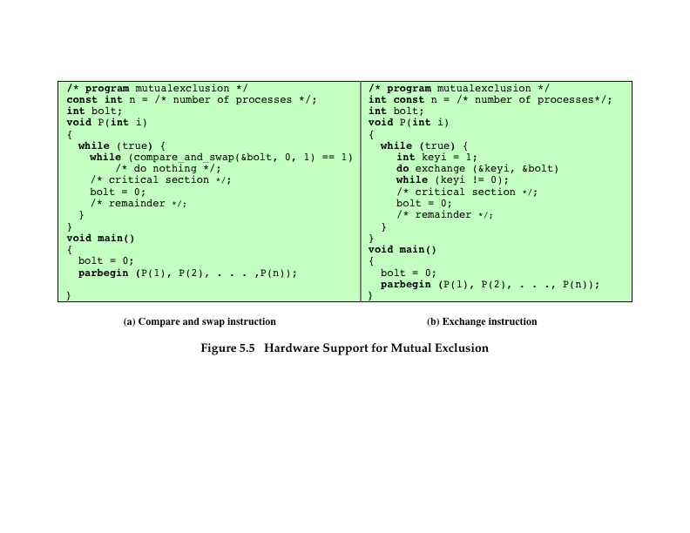
Notes:
Figure 5.5a shows a mutual exclusion protocol based on the use of this instruction. A shared variable bolt is initialized to 0. The only process that may enter its critical section is one that finds bolt equal to 0. All other processes attempting to enter their critical section go into a busy waiting mode. The term busy waiting , or spin waiting , refers to a technique in which a process can do nothing until it gets permission to enter its critical section but continues to execute an instruction or set of instructions that tests the appropriate variable to gain entrance. When a process leaves its critical section, it resets bolt to 0; at this point one and only one of the waiting processes is granted access to its critical section. The choice of process depends on which process happens to execute the compare & swap instruction next.
Figure 5.5b shows a mutual exclusion protocol based on the use of an exchange instruction. A shared variable bolt is initialized to 0. Each process uses a local variable key that is initialized to 1. The only process that may enter its critical section is one that finds bolt equal to 0. It excludes all other processes from the critical section by setting bolt to 1. When a process leaves its critical section, it resets bolt to 0, allowing another process to gain access to its critical section.

Slide 23
Special Machine Instruction: Advantages
Applicable to any number of processes on either a single processor or multiple processors sharing main memory
Simple and easy to verify
It can be used to support multiple critical sections; each critical section can be defined by its own variable
Notes:
The use of a special machine instruction to enforce mutual exclusion has a number of advantages:
• It is applicable to any number of processes on either a single processor or multiple processors sharing main memory.
• It is simple and therefore easy to verify.
• It can be used to support multiple critical sections; each critical section can be defined by its own variable.

Slide 24
Special Machine Instruction: Disadvantages
Busy-waiting is employed
Thus while a process is waiting for access to a critical section it continues to consume processor time
Starvation is possible
When a process leaves a critical section and more than one process is waiting, the selection of a waiting process is arbitrary; some process could indefinitely be denied access
Deadlock is possible
Notes:
There are some serious disadvantages:
• Busy waiting is employed: Thus, while a process is waiting for access to a critical section, it continues to consume processor time.
Starvation is possible: When a process leaves a critical section and more than one process is waiting, the selection of a waiting process is arbitrary. Thus, some process could indefinitely be denied access.
•
Deadlock is possible: Consider the following scenario on a single-processor system. Process P1 executes the special instruction (e.g., compare & swap, exchange ) and enters its critical section. P1 is then interrupted to give the processor to P2, which has higher priority. If P2 now attempts to use the same resource as P1, it will be denied access because of the mutual exclusion mechanism. Thus, it will go into a busy waiting loop. However, P1 will never be dispatched because it is of lower priority than another ready process, P2.
Because of the drawbacks of both the software and hardware solutions just outlined, we need to look for other mechanisms.

Slide 25
Table 5.3
Common
Concurrency
Mechanisms
Notes:
We now turn to OS and programming language mechanisms that are used to provide concurrency. Table 5.3 summarizes mechanisms in common use. We begin, in this section, with semaphores. The next two sections discuss monitors and message passing. The other mechanisms in Table 5.3 are discussed when treating specific operating system examples, in Chapters 6 and 13 .

Slide 26
Semaphore
A variable that has an integer value upon which only three operations are defined:
There is no way to inspect or manipulate semaphores other than these three operations
A semaphore may be initialized to a nonnegative integer value
The semWait operation decrements the semaphore value
The semSignal operation increments the semaphore value
Notes:
The first major advance in dealing with the problems of concurrent processes
came in 1965 with Dijkstra’s treatise [DIJK65]. Dijkstra was concerned with the
design of an OS as a collection of cooperating sequential processes, and with the
development of efficient and reliable mechanisms for supporting cooperation. These
mechanisms can just as readily be used by user processes if the processor and OS
make the mechanisms available.
The fundamental principle is this: Two or more processes can cooperate by means of simple signals, such that a process can be forced to stop at a specified place until it has received a specific signal. Any complex coordination requirement can be satisfied by the appropriate structure of signals. For signaling, special variables called semaphores are used. To transmit a signal via semaphore s , a process executes the primitive semSignal(s) . To receive a signal via semaphore s , a process executes the primitive semWait(s) ; if the corresponding signal has not yet been transmitted, the process is suspended until the transmission takes place.
To achieve the desired effect, we can view the semaphore as a variable that has an integer value upon which only three operations are defined:
1. A semaphore may be initialized to a nonnegative integer value.
2. The semWait operation decrements the semaphore value. If the value becomes negative, then the process executing the semWait is blocked.
Otherwise, the process continues execution.
3. The semSignal operation increments the semaphore value. If the resulting value is less than or equal to zero, then a process blocked by a semWait operation, if any, is unblocked.
Other than these three operations, there is no way to inspect or manipulate semaphores.
We explain these operations as follows. To begin, the semaphore has a zero or positive value. If the value is positive, that value equals the number of processes that can issue a wait and immediately continue to execute. If the value is zero, either by initialization or because a number of processes equal to the initial semaphore value have issued a wait, the next process to issue a wait is blocked, and the semaphore value goes negative. Each subsequent wait drives the semaphore value further into minus territory. The negative value equals the number of processes waiting to be unblocked. Each signal unblocks one of the waiting processes when the semaphore value is negative.

Slide 27
Consequences
There is no way to know before a process decrements a semaphore whether it will block or not
There is no way to know which process will continue immediately on a uniprocessor system when two processes are running concurrently
You don’t know whether another process is waiting so the number of unblocked processes may be zero or one
Notes:
[DOWN08] points out three interesting consequences of the semaphore definition:
• In general, there is no way to know before a process decrements a semaphore whether it will block or not.
After a process increments a semaphore and another process gets woken up, both processes continue running concurrently. There is no way to know which process, if either, will continue immediately on a uniprocessor system.
• When you signal a semaphore, you don’t necessarily know whether another process is waiting, so the number of unblocked processes may be zero or one.

Slide 28
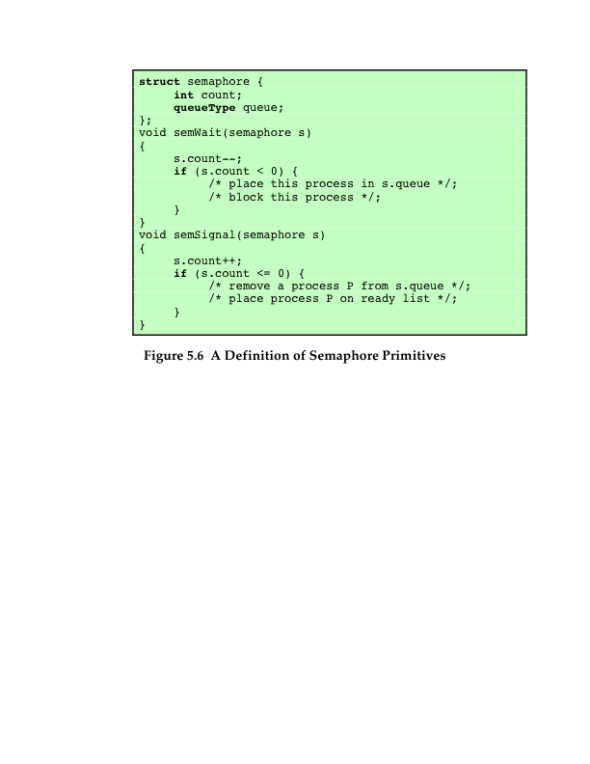
Notes:
Figure 5.6 suggests a more formal definition of the primitives for semaphores. The semWait and semSignal primitives are assumed to be atomic.

Slide 29
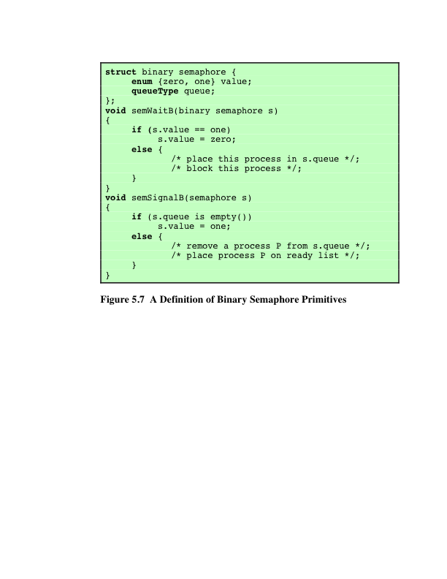
Notes:
A more restricted version, known as the binary semaphore , is defined in Figure 5.7 . A binary semaphore may only take on the values 0 and 1 and can be defined by the following three operations:
1. A binary semaphore may be initialized to 0 or 1.
2. The semWaitB operation checks the semaphore value. If the value is zero, then the process executing the semWaitB is blocked. If the value is one, then the value is changed to zero and the process continues execution.
3. The semSignalB operation checks to see if any processes are blocked on this semaphore (semaphore value equals 0). If so, then a process blocked by a semWaitB operation is unblocked. If no processes are blocked, then the value of the semaphore is set to one.
In principle, it should be easier to implement the binary semaphore, and it can be shown that it has the same expressive power as the general semaphore (see Problem 5.19). To contrast the two types of semaphores, the nonbinary semaphore is often referred to as either a counting semaphore or a general semaphore .
A concept related to the binary semaphore is the mutual exclusion lock
(mutex) . A mutex is a programming flag used to grab and release an object. When
data are acquired that cannot be shared or processing is started that cannot be
performed simultaneously elsewhere in the system, the mutex is set to lock (typically
zero), which blocks other attempts to use it. The mutex is set to unlock
when the data are no longer needed or the routine is finished. A key difference
between the a mutex and a binary semaphore is that the process that locks the
mutex (sets the value to zero) must be the one to unlock it (sets the value to 1). In
contrast, it is possible for one process to lock a binary semaphore and for another
to unlock it.

Slide 30
Strong/Weak Semaphores
A queue is used to hold processes waiting on the semaphore
Strong Semaphores
The process that has been blocked the longest is released from the queue first (FIFO)
Weak Semaphores
The order in which processes are removed from the queue is not specified
Notes:
For both counting semaphores and binary semaphores, a queue is used to hold processes waiting on the semaphore. The question arises of the order in which processes are removed from such a queue. The fairest removal policy is first-in-first-out (FIFO): The process that has been blocked the longest is released from the queue first; a semaphore whose definition includes this policy is called a strong semaphore . A semaphore that does not specify the order in which processes are removed from the queue is a weak semaphore .

Slide 31
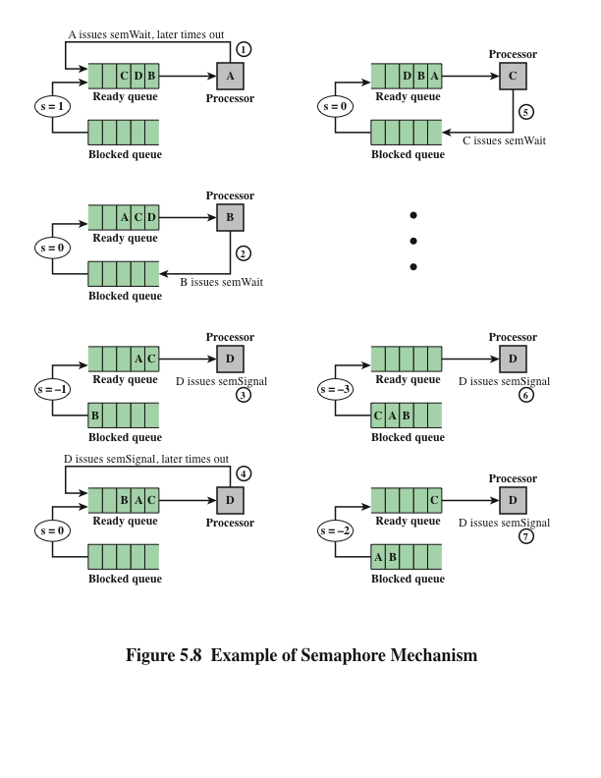
Notes:
Figure 5.8 is an example of the operation of a strong semaphore. Here processes A, B, and C depend on a result from process D. Initially (1), A is running;
B, C, and D are ready; and the semaphore count is 1, indicating that one of D’s results is available. When A issues a semWait instruction on semaphore s , the semaphore decrements to 0, and A can continue to execute; subsequently it rejoins the ready queue. Then B runs (2), eventually issues a semWait instruction, and is blocked, allowing D to run (3). When D completes a new result, it issues a semSignal instruction, which allows B to move to the ready queue (4). D rejoins the ready queue and C begins to run (5) but is blocked when it issues a semWait instruction. Similarly, A and B run and are blocked on the semaphore, allowing D to resume execution (6). When D has a result, it issues a semSignal , which transfers C to the ready queue. Later cycles of D will release A and B from the Blocked state.

Slide 32
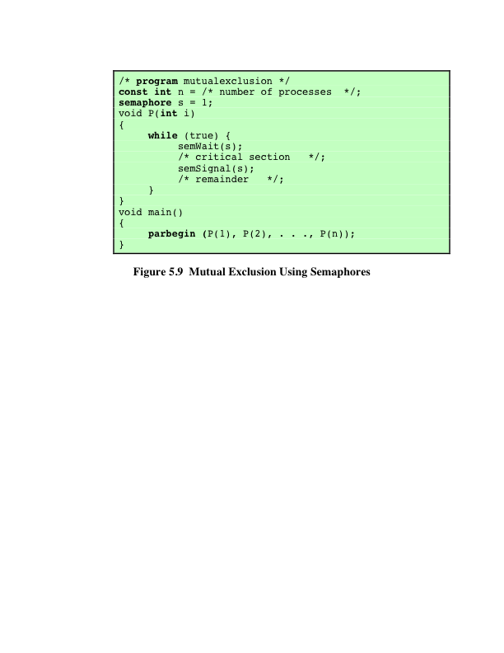
Notes:
For the mutual exclusion algorithm discussed in the next subsection and illustrated in Figure 5.9 , strong semaphores guarantee freedom from starvation, while weak semaphores do not. We will assume strong semaphores because they are more convenient and because this is the form of semaphore typically provided by operating systems.
Figure 5.9 shows a straightforward solution to the mutual exclusion problem using a semaphore s (compare Figure 5.4 ). Consider n processes, identified in the array P ( i ), all of which need access to the same resource. Each process has a critical section used to access the resource. In each process, a semWait(s) is executed just before its critical section. If the value of s becomes negative, the process is blocked. If the value is 1, then it is decremented to 0 and the process immediately enters its critical section; because s is no longer positive, no other process will be able to enter its critical section.
The semaphore is initialized to 1. Thus, the first process that executes a semWait will be able to enter the critical section immediately, setting the value of s to 0. Any other process attempting to enter the critical section will find it busy and will be blocked, setting the value of s to –1. Any number of processes may attempt entry; each such unsuccessful attempt results in a further decrement of the value of s . When the process that initially entered its critical section departs, s is incremented and one of the blocked processes (if any) is removed from the queue of blocked processes associated with the semaphore and put in a Ready state. When it is next scheduled by the OS, it may enter the critical section.

Slide 33
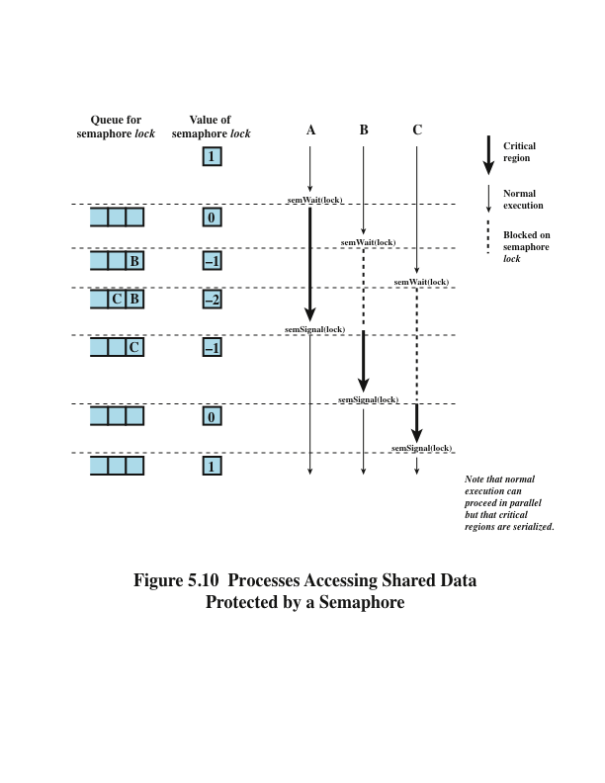
Notes:
Figure 5.10, based on one in [BACO03], shows a possible sequence for three
processes using the mutual exclusion discipline of Figure 5.9. In this example three
processes (A, B, C) access a shared resource protected by the semaphore lock .
Process A executes semWait (lock) ; because the semaphore has a value of 1 at
the time of the semWait operation, A can immediately enter its critical section and
the semaphore takes on the value 0. While A is in its critical section, both B and
C perform a semWait operation and are blocked pending the availability of the
semaphore. When A exits its critical section and performs semSignal (lock) , B,
which was the first process in the queue, can now enter its critical section.

Slide 34
Producer/Consumer Problem
General Statement:
One or more producers are generating data and placing these in a buffer
A single consumer is taking items out of the buffer one at a time
Only one producer or consumer may access the buffer at any one time
The Problem:
Ensure that the producer won’t try to add data into the buffer if its full, and that the consumer won’t try to remove data from an empty buffer
Notes:
We now examine one of the most common problems faced in concurrent processing: the producer/consumer problem. The general statement is this: There are one or more producers generating some type of data (records, characters) and placing these in a buffer. There is a single consumer that is taking items out of the buffer one at a time. The system is to be constrained to prevent the overlap of buffer operations. That is, only one agent (producer or consumer) may access the buffer at any one time. The problem is to make sure that the producer won’t try to add data into the buffer if it’s full and that the consumer won’t try to remove data from an empty buffer. We will look at a number of solutions to this problem to illustrate both the power and the pitfalls of semaphores.

Slide 35
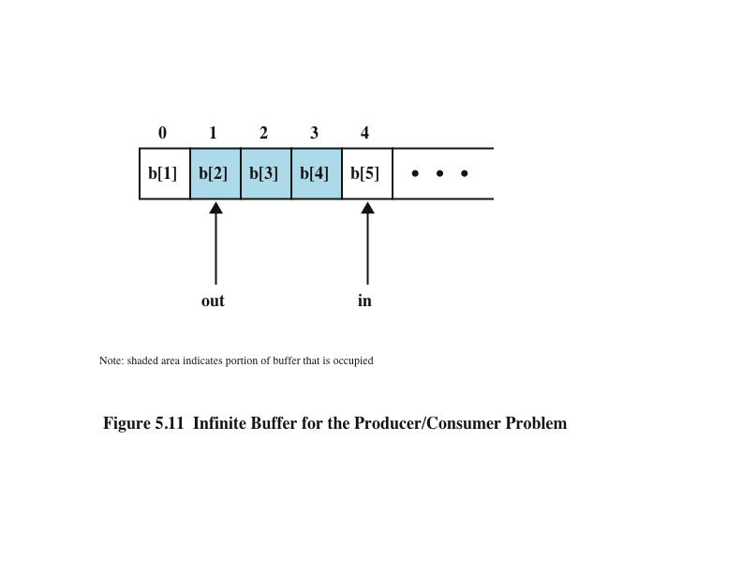
Notes:
Figure 5.11 illustrates the structure of buffer b . The producer can generate items and store them in the buffer at its own pace. Each time, an index ( in ) into the buffer is incremented. The consumer proceeds in a similar fashion but must make sure that it does not attempt to read from an empty buffer. Hence, the consumer makes sure that the producer has advanced beyond it ( in > out ) before proceeding.

Slide 36
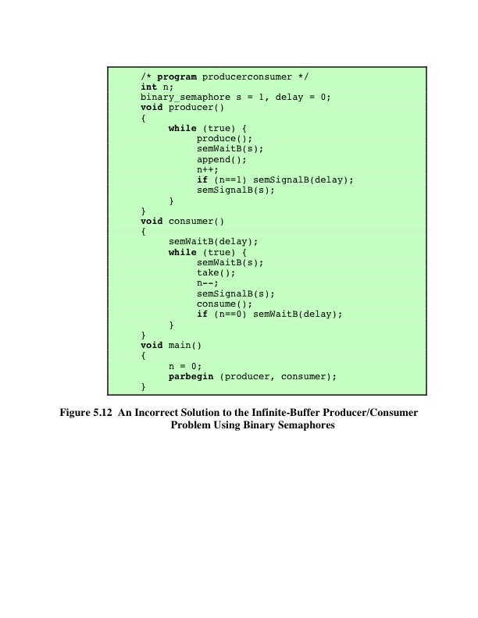
Notes:
Let us try to implement this system using binary semaphores. Figure 5.12 is a first attempt. Rather than deal with the indices in and out , we can simply keep track of the number of items in the buffer, using the integer variable n (= in – out ). The semaphore s is used to enforce mutual exclusion; the semaphore delay is used to force the consumer to semWait if the buffer is empty.
This solution seems rather straightforward. The producer is free to add to the buffer at any time. It performs semWaitB(s) before appending and semSignalB(s) afterward to prevent the consumer or any other producer from accessing the buffer during the append operation. Also, while in the critical section, the producer increments the value of n . If n = 1, then the buffer was empty just prior to this append, so the producer performs semSignalB(delay) to alert the consumer of this fact. The consumer begins by waiting for the first item to be produced,
using semWaitB(delay) . It then takes an item and decrements n in its critical section. If the producer is able to stay ahead of the consumer (a common situation), then the consumer will rarely block on the semaphore delay because n will usually be positive. Hence both producer and consumer run smoothly.
There is, however, a flaw in this program. When the consumer has exhausted the buffer, it needs to reset the delay semaphore so that it will be forced to wait until the producer has placed more items in the buffer. This is the purpose of the statement: if n == 0 semWaitB(delay) .

Slide 37
Table 5.4
Possible Scenario for the Program of Figure 5.12
Note: White areas represent the critical section controlled by semaphore s.
Notes:
Consider the scenario outlined in Table 5.4 . In line 14, the consumer fails to execute the semWaitB operation. The consumer did indeed exhaust the buffer and set n to 0 (line 8), but the producer has incremented n before the consumer can test it in line 14. The result is a semSignalB not matched by a prior semWaitB . The value of –1 for n in line 20 means that the consumer has consumed an item from the buffer that does not exist. It would not do simply to move the conditional statement inside the critical section of the consumer because this
could lead to deadlock (e.g., after line 8 of Table 5.4 ).

Slide 38
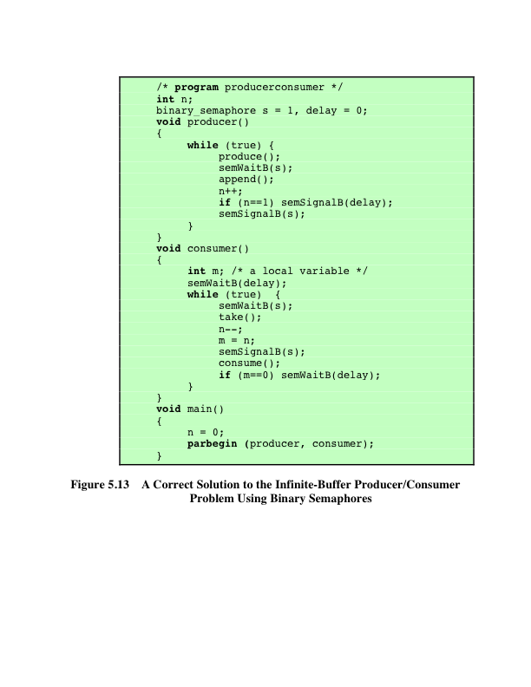
Notes:
A fix for the problem is to introduce an auxiliary variable that can be set in the consumer’s critical section for use later on. This is shown in Figure 5.13 . A careful trace of the logic should convince you that deadlock can no longer occur.

Slide 39
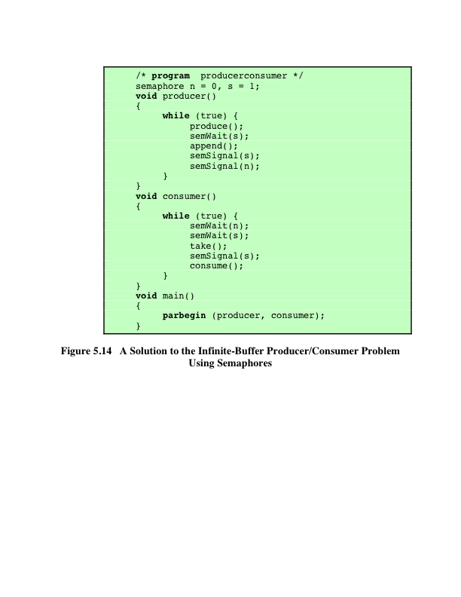
Notes:
A somewhat cleaner solution can be obtained if general semaphores (also called counting semaphores) are used, as shown in Figure 5.14 . The variable n is now a semaphore. Its value still is equal to the number of items in the buffer. Suppose now that in transcribing this program, a mistake is made and the operations semSignal(s) and semSignal(n) are interchanged. This would require that the semSignal(n) operation be performed in the producer’s critical section without interruption by the consumer or another producer. Would this affect the program? No, because the consumer must wait on both semaphores before proceeding in any case.

Slide 40
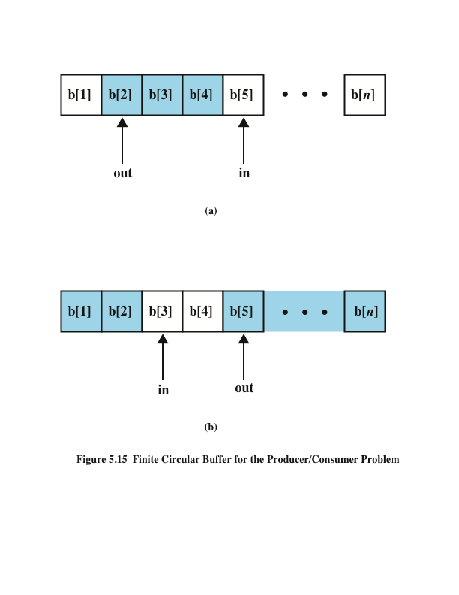
Notes:
Finally, let us add a new and realistic restriction to the producer/consumer problem: namely, that the buffer is finite. The buffer is treated as a circular storage ( Figure 5.15 ), and pointer values must be expressed modulo the size of the buffer.

Slide 41
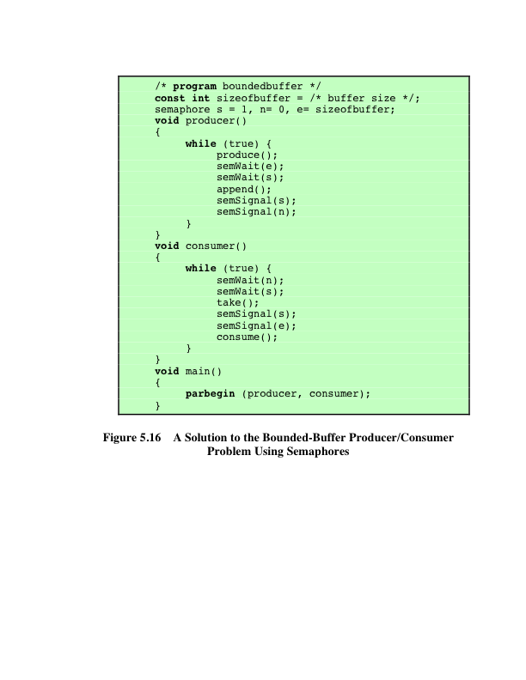
Notes:
Figure 5.16 shows a solution using general semaphores. The semaphore e has been added to keep track of the number of empty spaces.

Slide 42
Implementation of Semaphores
Imperative that the semWait and semSignal operations be implemented as atomic primitives
Can be implemented in hardware or firmware
Software schemes such as Dekker’s or Peterson’s algorithms can be used
Another alternative is to use one of the hardware-supported schemes for mutual exclusion
Notes:
As was mentioned earlier, it is imperative that the semWait and semSignal operations be implemented as atomic primitives. One obvious way is to implement them in hardware or firmware. Failing this, a variety of schemes have been suggested. The essence of the problem is one of mutual exclusion: Only one process at a time may manipulate a semaphore with either a semWait or semSignal operation. Thus, any of the software schemes, such as Dekker’s algorithm or Peterson’s algorithm ( Appendix A ), could be used; this would entail a substantial processing overhead.
Another alternative is to use one of the hardware-supported schemes for mutual exclusion.

Slide 43
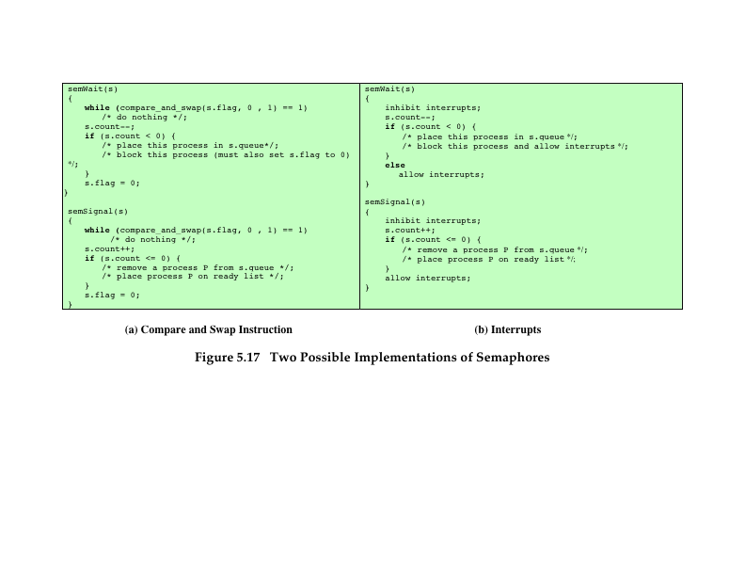
Notes:
Figure 5.17 shows the use of a compare&swap instruction.
In this implementation, the semaphore is again a structure, as in Figure 5.6,
but now includes a new integer component, s.flag . Admittedly, this involves a form
of busy waiting. However, the semWait and semSignal operations are relatively
short, so the amount of busy waiting involved should be minor.
For a single-processor system, it is possible to inhibit interrupts for the duration
of a semWait or semSignal operation, as suggested in Figure 5.17b. Once
again, the relatively short duration of these operations means that this approach is
reasonable.

Slide 44
Monitors
Programming language construct that provides equivalent functionality to that of semaphores and is easier to control
Implemented in a number of programming languages
Concurrent Pascal, Pascal-Plus, Modula-2, Modula-3, Java
Has also been implemented as a program library
Software module consisting of one or more procedures, an initialization sequence, and local data
Notes:
The monitor is a programming-language construct that provides equivalent functionality to that of semaphores and that is easier to control. The concept was first formally defined in [HOAR74]. The monitor construct has been implemented in a number of programming languages, including Concurrent Pascal, Pascal-Plus, Modula-2, Modula-3, and Java. It has also been implemented as a program library. This allows programmers to put a monitor lock on any object. In particular, for something like a linked list, you may want to lock all linked lists with one lock, or have one lock for each list, or have one lock for each element of each list.
A monitor is a software module consisting of one or more procedures, an initialization sequence, and local data.

Slide 45
Monitor Characteristics
Local data variables are accessible only by the monitor’s procedures and not by any external procedure
Process enters monitor by invoking one of its procedures
Only one process may be executing in the monitor at a time
Notes:
The chief characteristics of a monitor are the following:
1. The local data variables are accessible only by the monitor’s procedures and
not by any external procedure.
2. A process enters the monitor by invoking one of its procedures.
3. Only one process may be executing in the monitor at a time; any other processes
that have invoked the monitor are blocked, waiting for the monitor to become available.
The first two characteristics are reminiscent of those for objects in object-oriented software. Indeed, an object-oriented OS or programming language can readily implement a monitor as an object with special characteristics.
By enforcing the discipline of one process at a time, the monitor is able to provide a mutual exclusion facility. The data variables in the monitor can be accessed by only one process at a time. Thus, a shared data structure can be protected by placing it in a monitor. If the data in a monitor represent some resource, then the monitor provides a mutual exclusion facility for accessing the resource.
To be useful for concurrent processing, the monitor must include synchronization tools. For example, suppose a process invokes the monitor and, while in the
monitor, must be blocked until some condition is satisfied. A facility is needed by which the process is not only blocked but releases the monitor so that some other process may enter it. Later, when the condition is satisfied and the monitor is again available, the process needs to be resumed and allowed to reenter the monitor at the point of its suspension.

Slide 46
Synchronization
A monitor supports synchronization by the use of condition variables that are contained within the monitor and accessible only within the monitor
Condition variables are a special data type in monitors which are operated on by two functions:
cwait(c): suspend execution of the calling process on condition c
csignal(c): resume execution of some process blocked after a cwait on the same condition
Notes:
A monitor supports synchronization by the use of condition variables that are contained within the monitor and accessible only within the monitor. Condition variables are a special data type in monitors, which are operated on by two functions:
• cwait(c) : Suspend execution of the calling process on condition c . The monitor is now available for use by another process.
• csignal(c) : Resume execution of some process blocked after a cwait on the same condition. If there are several such processes, choose one of them; if there is no such process, do nothing.
Note that monitor wait and signal operations are different from those for the semaphore. If a process in a monitor signals and no task is waiting on the condition variable, the signal is lost.

Slide 47
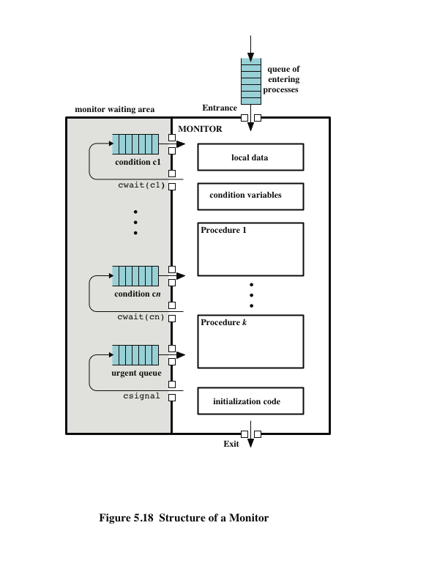
Notes:
Figure 5.18 illustrates the structure of a monitor. Although a process can enter the monitor by invoking any of its procedures, we can think of the monitor as having a single entry point that is guarded so that only one process may be in the monitor at a time. Other processes that attempt to enter the monitor join a queue of processes blocked waiting for monitor availability. Once a process is in the monitor, it may temporarily block itself on condition x by issuing cwait(x) ; it is then placed in a queue of processes waiting to reenter the monitor when the condition changes, and resume execution at the point in its program following the cwait(x) call.
If a process that is executing in the monitor detects a change in the condition variable x , it issues csignal(x) , which alerts the corresponding condition queue that the condition has changed.

Slide 48
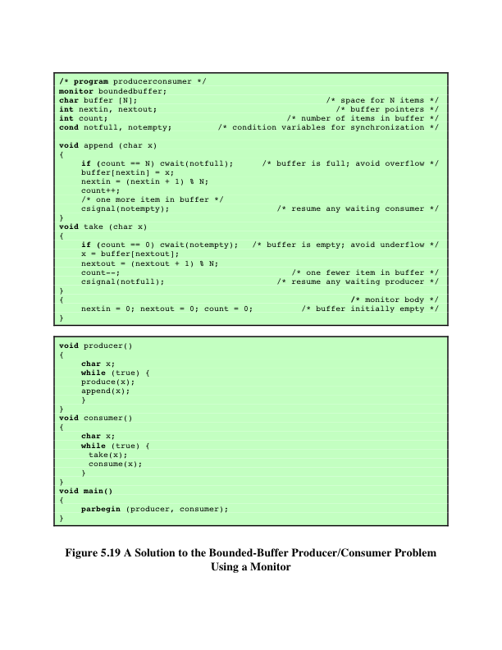
Notes:
As an example of the use of a monitor, let us return to the bounded-buffer producer/consumer problem. Figure 5.19 shows a solution using a monitor. The monitor module, boundedbuffer , controls the buffer used to store and retrieve characters. The monitor includes two condition variables (declared with the construct cond ): notfull is true when there is room to add at least one character to the buffer, and notempty is true when there is at least one character in the buffer.
A producer can add characters to the buffer only by means of the procedure append inside the monitor; the producer does not have direct access to buffer . The procedure first checks the condition notfull to determine if there is space available in the buffer. If not, the process executing the monitor is blocked on that condition. Some other process (producer or consumer) may now enter the monitor. Later, when the buffer is no longer full, the blocked process may be removed from the queue, reactivated, and resume processing. After placing a character in the buffer, the process signals the notempty condition. A similar description can be made of the consumer function.
This example points out the division of responsibility with monitors compared to semaphores. In the case of monitors, the monitor construct itself enforces mutual exclusion: It is not possible for both a producer and a consumer simultaneously to access the buffer. However, the programmer must place the appropriate cwait and csignal primitives inside the monitor to prevent processes from depositing items in a full buffer or removing them from an empty one. In the case of semaphores, both mutual exclusion and synchronization are the responsibility of the programmer.
Note that in Figure 5.19, a process exits the monitor immediately after executing the csignal function. If the csignal does not occur at the end of the procedure, then, in Hoare’s proposal, the process issuing the signal is blocked to make the monitor available and placed in a queue until the monitor is free. One possibility at this point would be to place the blocked process in the entrance queue, so that it would have to compete for access with other processes that had not yet entered the monitor. However, because a process blocked on a csignal function has already partially performed its task in the monitor, it makes sense to give this process precedence over newly entering processes by setting up a separate urgent queue ( Figure 5.18 ). One language that uses monitors, Concurrent Pascal, requires that csignal only appear as the last operation executed by a monitor procedure.
If there are no processes waiting on condition x , then the execution of csignal( x ) has no effect.
As with semaphores, it is possible to make mistakes in the synchronization function
of monitors. For example, if either of the csignal functions in the boundedbuffer
monitor are omitted, then processes entering the corresponding condition
queue are permanently hung up. The advantage that monitors have over semaphores
is that all of the synchronization functions are confined to the monitor. Therefore, it
is easier to verify that the synchronization has been done correctly and to detect bugs.
Furthermore, once a monitor is correctly programmed, access to the protected resource
is correct for access from all processes. In contrast, with semaphores, resource access is
correct only if all of the processes that access the resource are programmed correctly.

Slide 49
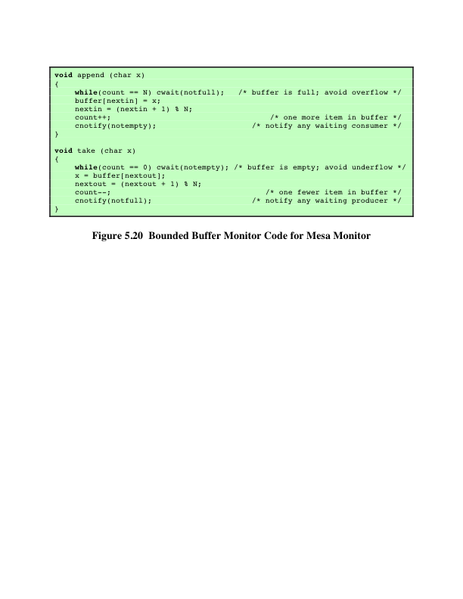
Notes:
Hoare’s definition of monitors [HOAR74] requires that if there is at least one process
in a condition queue, a process from that queue runs immediately when another
process issues a csignal for that condition. Thus, the process issuing the
csignal must either immediately exit the monitor or be blocked on the monitor.
Lampson and Redell developed a different definition of monitors for the
language Mesa [LAMP80]. Their approach overcomes the problems just listed
and supports several useful extensions. The Mesa monitor structure is also used in
the Modula-3 systems programming language [NELS91]. In Mesa, the csignal
primitive is replaced by cnotify , with the following interpretation: When a process
executing in a monitor executes cnotify(x), it causes the x condition queue
to be notified, but the signaling process continues to execute. The result of the notification
is that the process at the head of the condition queue will be resumed at
some convenient future time when the monitor is available. However, because there
is no guarantee that some other process will not enter the monitor before the waiting
process, the waiting process must recheck the condition. For example, the procedures
in the boundedbuffer monitor would now have the code of Figure 5.20.
An advantage of Lampson/Redell monitors over Hoare monitors is that the
Lampson/Redell approach is less prone to error. In the Lampson/Redell approach,
because each procedure checks the monitor variable after being signaled, with the
use of the while construct, a process can signal or broadcast incorrectly without causing
an error in the signaled program. The signaled program will check the relevant
variable and, if the desired condition is not met, continue to wait.
Another advantage of the Lampson/Redell monitor is that it lends itself to a
more modular approach to program construction.

Slide 50
Message Passing
When processes interact with one another two fundamental requirements must be satisfied:
Message passing is one approach to providing both of these functions
Works with distributed systems and shared memory multiprocessor and uniprocessor systems
Synchronization
To enforce mutual exclusion
Communication
To exchange information
Notes:
When processes interact with one another, two fundamental requirements must be satisfied: synchronization and communication. Processes need to be synchronized to enforce mutual exclusion; cooperating processes may need to exchange information. One approach to providing both of these functions is message passing. Message passing has the further advantage that it lends itself to implementation in distributed systems as well as in shared-memory multiprocessor and uniprocessor systems.

Slide 51
Message Passing
The actual function is normally provided in the form of a pair of primitives:
send (destination, message)
receive (source, message)
A process sends information in the form of a message to another process designated by a destination
A process receives information by executing the receive primitive, indicating the source and the message
Notes:
Message-passing systems come in many forms. In this section, we provide a general introduction that discusses features typically found in such systems. The actual function of message passing is normally provided in the form of a pair of primitives:
send (destination, message)
receive (source, message)
This is the minimum set of operations needed for processes to engage in message passing. A process sends information in the form of a message to another process designated by a destination . A process receives information by executing the receive primitive, indicating the source and the message .

Slide 52
Table 5.5
Design Characteristics of Message Systems for
Interprocess Communication and Synchronization
Notes:
A number of design issues relating to message-passing systems are listed in Table 5.5 , and examined in the remainder of this section.

Slide 53
Synchronization
Communication of a message between two processes implies synchronization between the two
The receiver cannot receive a message until it has been sent by another process
When a receive primitive is executed in a process there are two possibilities:
If a message has previously been sent the message is received and execution continues
If there is no waiting message the process is blocked until a message arrives or the process continues to execute, abandoning the attempt to receive
Notes:
The communication of a message between two processes implies some level of synchronization between the two: The receiver cannot receive a message until it has been sent by another process. In addition, we need to specify what happens to a process after it issues a send or receive primitive.
Consider the send primitive first. When a send primitive is executed in a process, there are two possibilities: Either the sending process is blocked until the message is received, or it is not. Similarly, when a process issues a receive primitive, there are two possibilities:
1. If a message has previously been sent, the message is received and execution continues.
2. If there is no waiting message, then either (a) the process is blocked until a message arrives, or (b) the process continues to execute, abandoning the attempt to receive.

Slide 54
Blocking Send, Blocking Receive
Both sender and receiver are blocked until the message is delivered
Sometimes referred to as a rendezvous
Allows for tight synchronization between processes
Notes:
Thus, both the sender and receiver can be blocking or nonblocking. Three combinations are common, although any particular system will usually have only one or two combinations implemented:
• Blocking send, blocking receive: Both the sender and receiver are blocked until the message is delivered; this is sometimes referred to as a rendezvous . This combination allows for tight synchronization between processes.

Slide 55
Nonblocking Send
Nonblocking send, blocking receive
Sender continues on but receiver is blocked until the requested message arrives
Most useful combination
Sends one or more messages to a variety of destinations as quickly as possible
Example -- a service process that exists to provide a service or resource to other processes
Nonblocking send, nonblocking receive
Neither party is required to wait
Notes:
Nonblocking send, blocking receive: Although the sender may continue on, the receiver is blocked until the requested message arrives. This is probably the most useful combination. It allows a process to send one or more messages to a variety of destinations as quickly as possible. A process that must receive a message before it can do useful work needs to be blocked until such a message arrives. An example is a server process that exists to provide a service or resource to other processes.
• Nonblocking send, nonblocking receive: Neither party is required to wait.
The nonblocking send is more natural for many concurrent programming tasks. For example, if it is used to request an output operation, such as printing, it allows the requesting process to issue the request in the form of a message and then carry on. One potential danger of the nonblocking send is that an error could lead to a situation in which a process repeatedly generates messages. Because there is no blocking to discipline the process, these messages could consume system resources, including processor time and buffer space, to the detriment of other processes and the OS. Also, the nonblocking send places the burden on the programmer to determine that a message has been received: Processes must employ reply messages to acknowledge receipt of a message.
For the receive primitive, the blocking version appears to be more natural for many concurrent programming tasks. Generally, a process that requests a message will need the expected information before proceeding. However, if a message is lost, which can happen in a distributed system, or if a process fails before it sends an anticipated message, a receiving process could be blocked indefinitely. This problem can be solved by the use of the nonblocking receive . However, the danger of this approach is that if a message is sent after a process has already executed a matching receive , the message will be lost. Other possible approaches are to allow a process to test whether a message is waiting before issuing a receive and
allow a process to specify more than one source in a receive primitive. The latter approach is useful if a process is waiting for messages from more than one source and can proceed if any of these messages arrive.

Slide 56
Addressing
Schemes for specifying processes in send and receive primitives fall into two categories:
Direct addressing
Indirect addressing
Notes:
Clearly, it is necessary to have a way of specifying in the send primitive which process is to receive the message. Similarly, most implementations allow a receiving process to indicate the source of a message to be received.
The various schemes for specifying processes in send and receive primitives fall into two categories: direct addressing and indirect addressing.

Slide 57
Direct Addressing
Send primitive includes a specific identifier of the destination process
Receive primitive can be handled in one of two ways:
Require that the process explicitly designate a sending process
Effective for cooperating concurrent processes
Implicit addressing
Source parameter of the receive primitive possesses a value returned when the receive operation has been performed
Notes:
With direct addressing , the send primitive includes a specific identifier of the destination process. The receive primitive can be handled in one of two ways. One possibility is to require that the process explicitly designate a sending process. Thus, the process must know ahead of time from which process a message is expected. This will often be effective for cooperating concurrent processes. In other cases, however, it is impossible to specify the anticipated source process. An example is a printer server process, which will accept a print request message from any other process. For such applications, a more effective approach is the use of implicit addressing. In this case, the source parameter of the receive primitive possesses a value returned when the receive operation has been performed.

Slide 58
Indirect Addressing
Messages are sent to a shared data structure consisting of queues that can temporarily hold messages
Queues are referred to as mailboxes
One process sends a message to the mailbox and the other process picks up the message from the mailbox
Allows for greater flexibility in the use of messages
Notes:
The other general approach is indirect addressing . In this case, messages are not sent directly from sender to receiver but rather are sent to a shared data structure consisting of queues that can temporarily hold messages. Such queues are generally referred to as mailboxes . Thus, for two processes to communicate, one process sends a message to the appropriate mailbox and the other process picks up the message from the mailbox.
A strength of the use of indirect addressing is that, by decoupling the sender and receiver, it allows for greater flexibility in the use of messages.

Slide 59
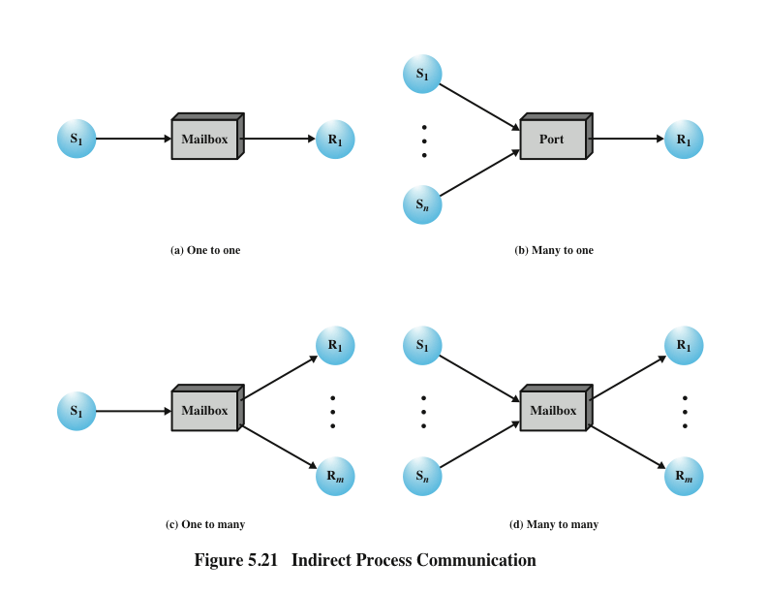
Notes:
The relationship between senders and receivers can be one to one, many to one, one to many, or many to many ( Figure 5.21 ). A one-to-one relationship allows a private communications link to be set up between two processes. This insulates their interaction from erroneous interference from other processes. A many-to-one relationship is useful
for client/server interaction; one process provides service to a number of other processes. In this case, the mailbox is often referred to as a port . A one-to-many relationship allows for one sender and multiple receivers; it is useful for applications where a message or some information is to be broadcast to a set of processes. A many-to-many relationship allows multiple server processes to provide concurrent service to multiple clients.
1) A one-to-one relationship
allows a private communications link to be set up between two processes.
This insulates their interaction from erroneous interference from other processes.
2) A many-to-one relationship is useful for client/server interaction;
one process provides service to a number of other processes.
In this case, the mailbox is often referred to as a port.
3) A one-to-many relationship allows for one sender and multiple receivers;
it is useful for applications where a message or some information is to be broadcast to a set of processes.
4) A many-to-many relationship
allows multiple server processes to provide concurrent service to multiple clients.
The association of processes to mailboxes can be either static or dynamic. Ports are often statically associated with a particular process; that is, the port is created and assigned to the process permanently. Similarly, a one-to-one relationship is typically defined statically and permanently. When there are many senders, the association of a sender to a mailbox may occur dynamically. Primitives such as connect and disconnect may be used for this purpose.
A related issue has to do with the ownership of a mailbox. In the case of a port, it is typically owned by and created by the receiving process. Thus, when the process is destroyed, the port is also destroyed. For the general mailbox case, the OS may offer a create-mailbox service. Such mailboxes can be viewed either as being owned by the creating process, in which case they terminate with the process, or as being owned by the OS, in which case an explicit command will be required to destroy the mailbox.

Slide 60
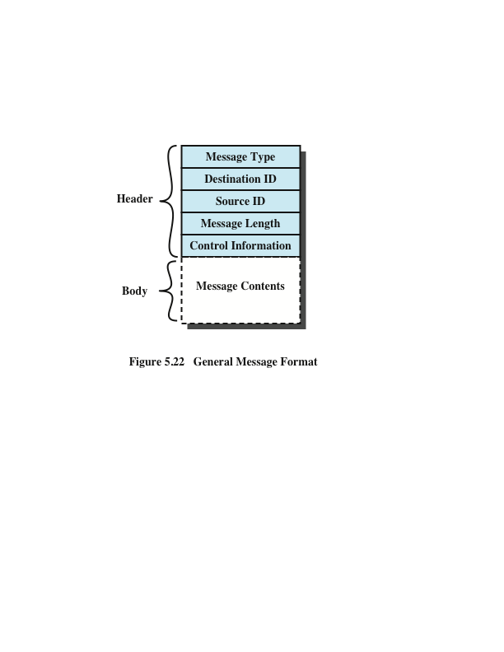
Notes:
The format of the message depends on the objectives of the messaging facility and whether the facility runs on a single computer or on a distributed system. For some operating systems, designers have preferred short, fixed-length messages to minimize processing and storage overhead. If a large amount of data is to be passed, the data can be placed in a file and the message then simply references that file. A more flexible approach is to allow variable-length messages.
Figure 5.22 shows a typical message format for operating systems that support variable-length messages.
The message is divided into two parts:
a header, which contains information about the message.
The header may contain an identification of the source and intended destination of the message, a length field, and a type field to discriminate among various types of messages.
additional control information, e.g. pointer field so a linked list of messages can be created; a sequence number, to keep track of the number and order of messages passed between source and destination; and a priority field.
a body, which contains the actual contents of the message.

Slide 61
Queueing Discipline
The simplest queueing discipline is first-in-first-out
This may not be sufficient if some message are more urgent than others
Other alternatives are:
To allow the specifying of message priority, on the basis of message type or by designation by the sender
To allow the receiver to inspect the message queue and select which message to receive next
Notes:
The simplest queueing discipline is first-in-first-out, but this may not be sufficient if
some messages are more urgent than others. An alternative is to allow the specifying
of message priority, on the basis of message type or by designation by the sender.
Another alternative is to allow the receiver to inspect the message queue and select
which message to receive next.

Slide 62
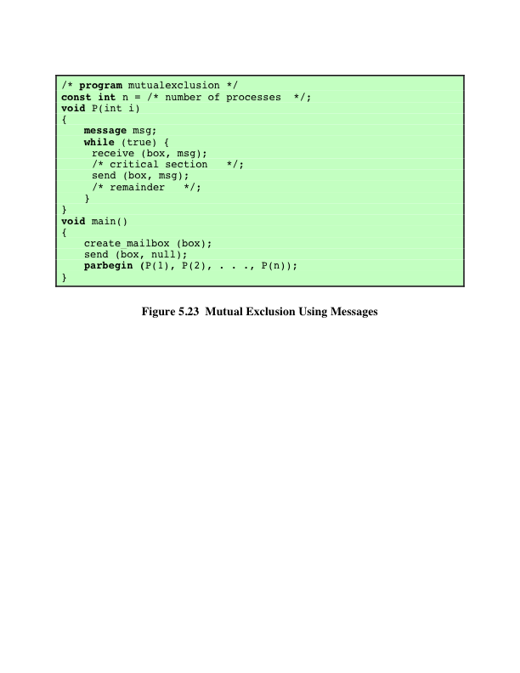
Notes:
Figure 5.23 shows one way in which message passing can be used to enforce mutual exclusion (compare Figures 5.4 , 5.5 , and 5.9 ). We assume the use of the blocking receive primitive and the nonblocking send primitive. A set of concurrent processes share a mailbox, box , which can be used by all processes to send and receive.
The mailbox is initialized to contain a single message with null content. A process wishing to enter its critical section first attempts to receive a message. If the mailbox is empty, then the process is blocked. Once a process has acquired the message, it performs its critical section and then places the message back into the mailbox. Thus, the message functions as a token that is passed from process to process.
The preceding solution assumes that if more than one process performs the receive operation concurrently, then:
• If there is a message, it is delivered to only one process and the others are
blocked, or
• If the message queue is empty, all processes are blocked; when a message is
available, only one blocked process is activated and given the message.
These assumptions are true of virtually all message-passing facilities.

Slide 63
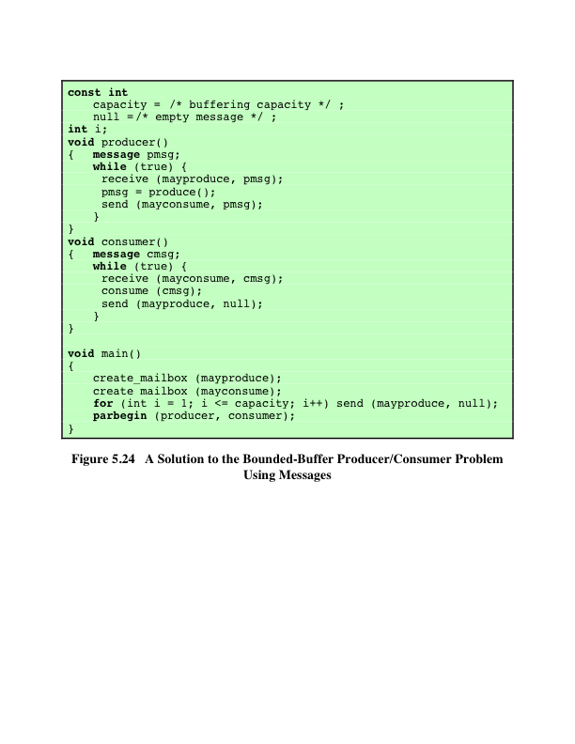
Notes:
As an example of the use of message passing, Figure 5.24 is a solution to the bounded-buffer producer/consumer problem. Using the basic mutual-exclusion power of message passing, the problem could have been solved with an algorithmic structure similar to that of Figure 5.16 . Instead, the program of Figure 5.24 takes advantage of the ability of message passing to be used to pass data in addition to signals. Two mailboxes are used. As the producer generates data, it is sent as messages to the mailbox mayconsume . As long as there is at least one message in that mailbox, the consumer can consume. Hence mayconsume serves as the buffer; the data in the buffer are organized as a queue of messages. The “size” of the buffer is
determined by the global variable capacity . Initially, the mailbox mayproduce is filled with a number of null messages equal to the capacity of the buffer. The number of messages in mayproduce shrinks with each production and grows with each consumption.
This approach is quite flexible. There may be multiple producers and consumers, as long as all have access to both mailboxes. The system may even be distributed, with all producer processes and the mayproduce mailbox at one site and all the consumer processes and the mayconsume mailbox at another.

Slide 64
Readers/Writers Problem
A data area is shared among many processes
Some processes only read the data area, (readers) and some only write to the data area (writers)
Conditions that must be satisfied:
Any number of readers may simultaneously read the file
Only one writer at a time may write to the file
If a writer is writing to the file, no reader may read it
Notes:
The readers/writers problem is defined as follows: There is a data area shared among a number of processes. The data area could be a file, a block of main memory, or even a bank of processor registers. There are a number of processes that only read the data area (readers) and a number that only write to the data area (writers). The conditions that must be satisfied are as follows:
1. Any number of readers may simultaneously read the file.
2. Only one writer at a time may write to the file.
3. If a writer is writing to the file, no reader may read it.
Thus, readers are processes that are not required to exclude one another and writers are processes that are required to exclude all other processes, readers and writers alike.

Slide 65
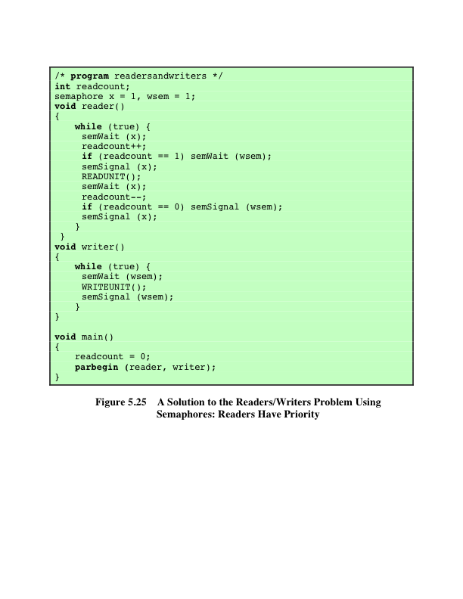
Notes:
Figure 5.25 is a solution using semaphores, showing one instance each of a reader and a writer; the solution does not change for multiple readers and writers. The writer process is simple. The semaphore wsem is used to enforce mutual exclusion. As long as one writer is accessing the shared data area, no other writers and no readers may access it. The reader process also makes use of wsem to enforce mutual exclusion. However, to allow multiple readers, we require that, when there are no readers reading, the first reader that attempts to read should wait on wsem . When there is already at least one reader reading, subsequent readers need not wait before entering. The global variable readcount is used to keep track of the number of readers, and the semaphore x is used to assure that readcount is updated properly.

Slide 66
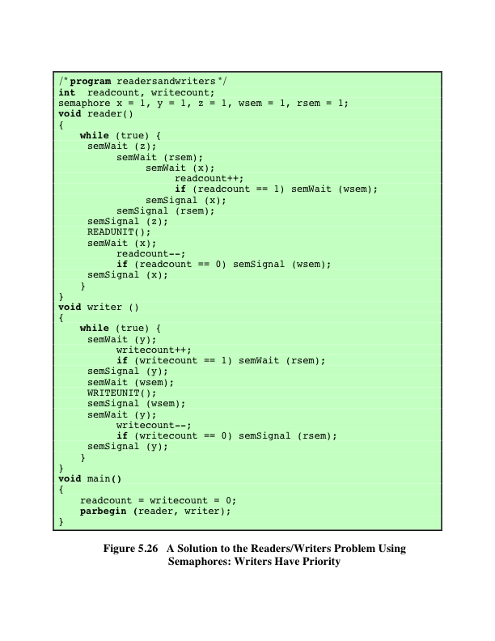
Notes:
In the previous solution, readers have priority. Once a single reader has begun to access the data area, it is possible for readers to retain control of the data area as long as there is at least one reader in the act of reading. Therefore, writers are subject to starvation.
Figure 5.26 shows a solution that guarantees that no new readers are allowed access to the data area once at least one writer has declared a desire to write. For writers, the following semaphores and variables are added to the ones already defined:
• A semaphore rsem that inhibits all readers while there is at least one writer desiring access to the data area
• A variable writecount that controls the setting of rsem
• A semaphore y that controls the updating of writecount

Slide 67
Table 5.6
State of the Process Queues for Program of Figure 5.26
Notes:
For readers, one additional semaphore is needed. A long queue must not be allowed to build up on rsem ; otherwise writers will not be able to jump the queue. Therefore, only one reader is allowed to queue on rsem , with any additional readers queuing on semaphore z , immediately before waiting on rsem . Table 5.6 summarizes the possibilities.

Slide 68
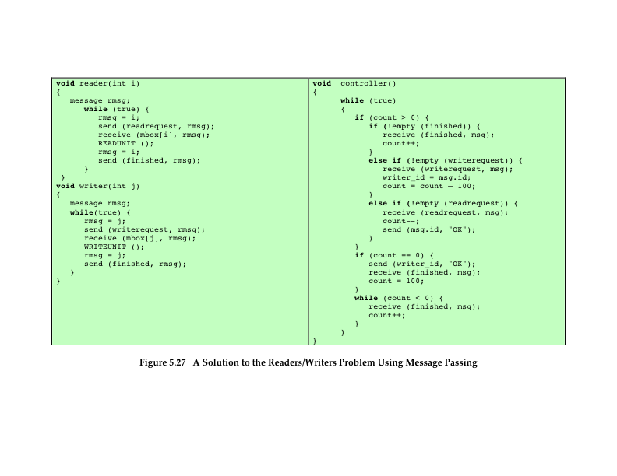
Notes:
An alternative solution, which gives writers priority and which is implemented using message passing, is shown in Figure 5.27 . In this case, there is a controller process that has access to the shared data area. Other processes wishing to access the data area send a request message to the controller, are granted access with an “OK” reply message, and indicate completion of access with a “finished” message. The controller is equipped with three mailboxes, one for each type of message that it may receive.
The controller process services write request messages before read request messages to give writers priority. In addition, mutual exclusion must be enforced. To do this the variable count is used, which is initialized to some number greater than the maximum possible number of readers. In this example, we use a value of 100. The action of the controller can be summarized as follows:
• If count > 0, then no writer is waiting and there may or may not be readers active. Service all “finished” messages first to clear active readers. Then service write requests and then read requests.
• If count = 0, then the only request outstanding is a write request. Allow the writer to proceed and wait for a “finished” message.
If count < 0, then a writer has made a request and is being made to wait to clear all active readers. Therefore, only “finished” messages should be serviced.

Slide 69
Summary
Mutual exclusion: software approaches
Dekker’s algorithm
Peterson’s algorithm
Principles of concurrency
Race condition
OS concerns
Process interaction
Requirements for mutual exclusion
Mutual exclusion: hardware support
Interrupt disabling
Special machine instructions
Semaphores
Mutual exclusion
Producer/consumer problem
Implementation of semaphores
Monitors
Monitor with signal
Alternate model of monitors with notify and broadcast
Message passing
Synchronization
Addressing
Message format
Queueing discipline
Mutual exclusion
Readers/writers problem
Readers have priority
Writers have priority
Notes:
Summary of Chapter 5.

